Slide 1

COURSEWORK COVERSHEET AND RECEIPT
(This form must be completed and attached to all assessed coursework)
BCUIC ID Number: | 172036
First Name: (PLEASE USE BLOCK CAPITALS) | Phuong Vi | Family Name: (PLEASE USE BLOCK CAPITALS) | Nguyen
Choose BCUIC Course:
 | First Year Degree in Business First Year Degree in Economics and Finance First Year Degree in Accountancy and Finance First Year Degree in Marketing, Advertising and PR First Year Degree in Technology, Engineering and Built Environment
 | Pre-masters in Art & Design Pre-masters in Law Pre-master in Business Pre-master in Technology, Engineering and Built Environment
x | Foundation in Art & Design Foundation in Law Foundation in Business Foundation in Technology, Engineering and Built Environment
Module Code: ART102 | Module Name: Media Experimentation in Art and Design
Lecturer/Tutor: Anna Maguire
Assignment Title: Assessment A
Type “YES” if you have uploaded your work on TURNITIN: x
Type “YES” if you have applied for Mitigating Circumstances:
Declaration: I can confirm that the work that I have submitted is my own original work and that I have made appropriate references to any sources used. I have read and understand that BCUIC plagiarism and collusion policy in the Academic Services/Student Handbook and confirm that this work complies with those guidelines. I confirm that the printed version of the assessment and any electronic copy I am required to submit via TURNITIN are identical. I understand that failure to meet the guidelines may result in one or more of the outlines penalties being imposed.
Signed: Phuong Vi Nguyen Date: 08/04/2026

Slide 2
ASSESSMENT & EXAMINATION FEEDBACK FORM
MODULE CODE | ART102 | STUDENT ID | 172036
SEMESTER | 2 | DATE | 08/04/2026
Additional Guidance:
Feedback provided in this form should be accompanied by corresponding annotations on the student’s script in the appropriate colour as follows:
RED = FIRST MARKER
GREEN = SECOND MARKER
The First Mark stands as the ‘Agreed Mark’ unless there is a deviation beyond 10%
Agreed Mark section is to be completed by the Second Marker with the mark entered matching the First Mark where there is a deviation of less than 10% to indicate agreement/confirmation. The additional section added for ‘Agreed Mark’ is to be completed / signed by the Second Marker where the deviation is less than 10%.
Where there is a deviation of more than 10% the First Marker and Second Marker are to consult further to reach a consensus on the Agreed Mark.
If a consensus cannot be reached between the First Marker and Second Marker a Third Marker / Moderator will be appointed by the Academic Services Team to confirm the Agreed Mark.
Where there is a deviation of more than 10% the First Marker and Second Marker are to consult further to reach a consensus on the Agreed Mark.
WordPress link | https://mango491.wordpress.com/
Section A
 | Mark Allocated | Percentage % | Signature
First Marker
Second marker
Agreed mark
Moderator (if applicable)
Signature (Moderator)
FIRST MARKER NAME (PRINT) |  | FIRST MARKER (SIGNATURE)

Slide 3
Section B (see comments below)
Overall Comments:
­­­­­­­­­Tips to improve your work (1st Marker) 1. 2. 3. The best part of the work was: ­­­­­­­­­­­­­­­
Second Markers Comments
I confirm agreement with the marking standards of this sample ☐ YES ☐ NO
___________________________________________________________________________________________________________________________________
___________________________________________________________________________________________________________________________________
___________________________________________________________________________________________________________________________________
Second Marker Signature:

Slide 4
My Theme
ID:25185750
LANDSCAPE AND ENVIRONMENT
Phuong Vi Nguyen

Slide 5
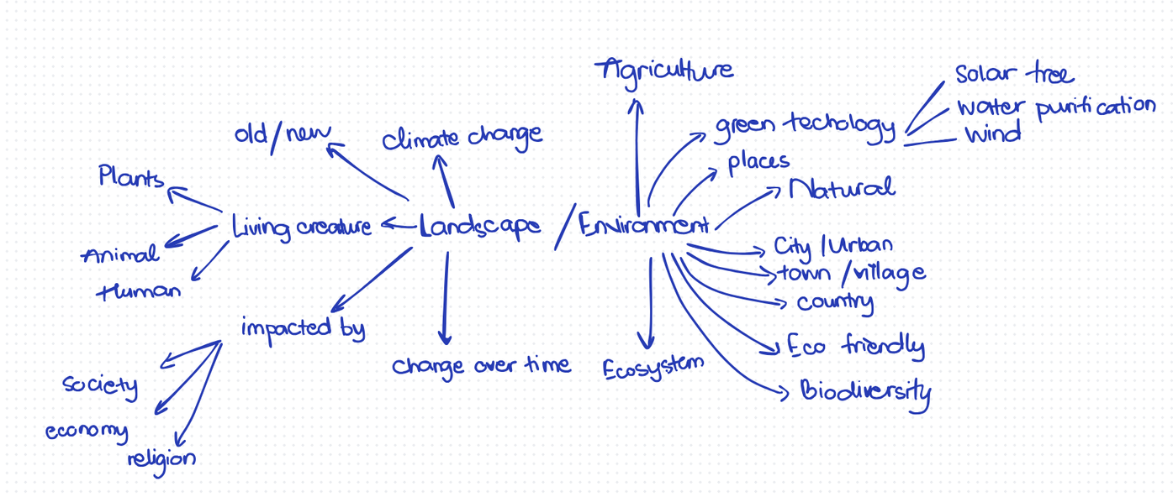
My theme
Main Goal
  Preserve the park by using the new and old tech that can also bring benefits for citizens' surroundings.
  The connections between human and natural environment
  Instead of viewing architecture and nature as two separate entities, I focus on where technology and landscape design can support each other.

Slide 6
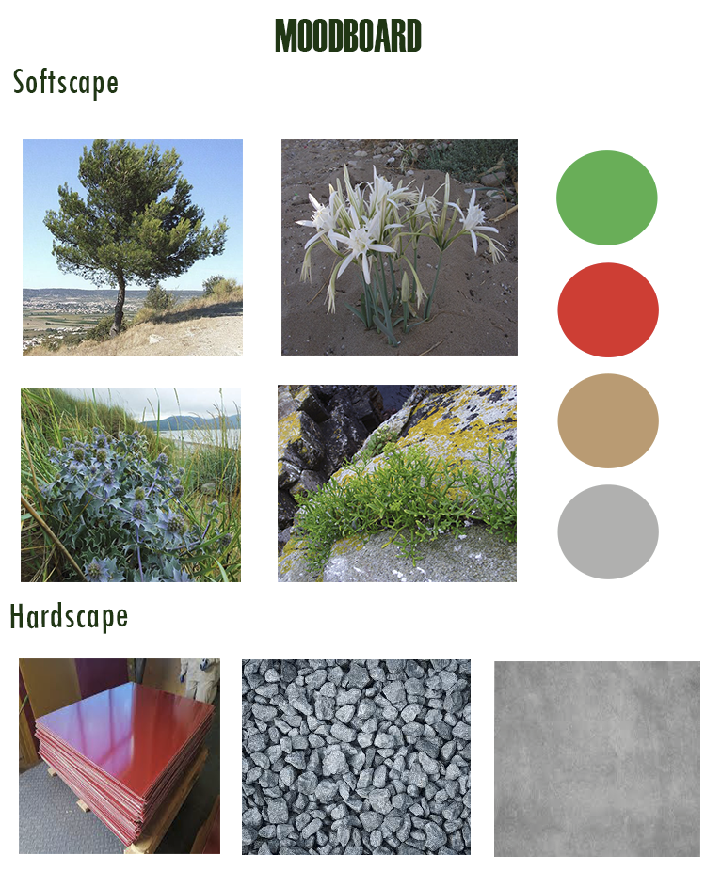
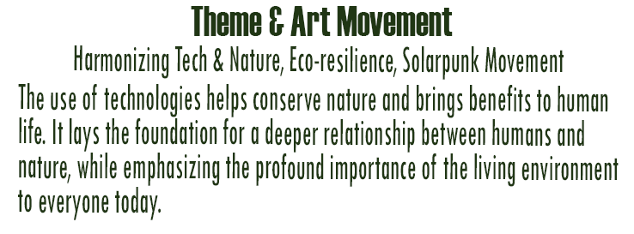

Slide 7
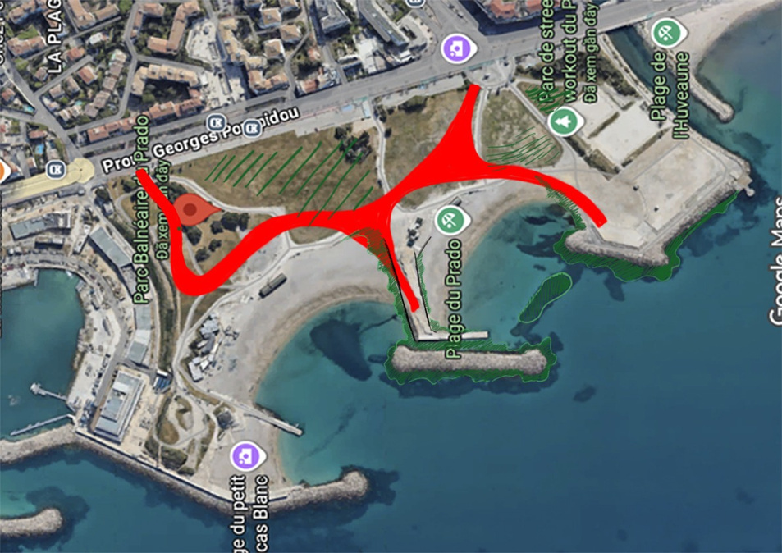
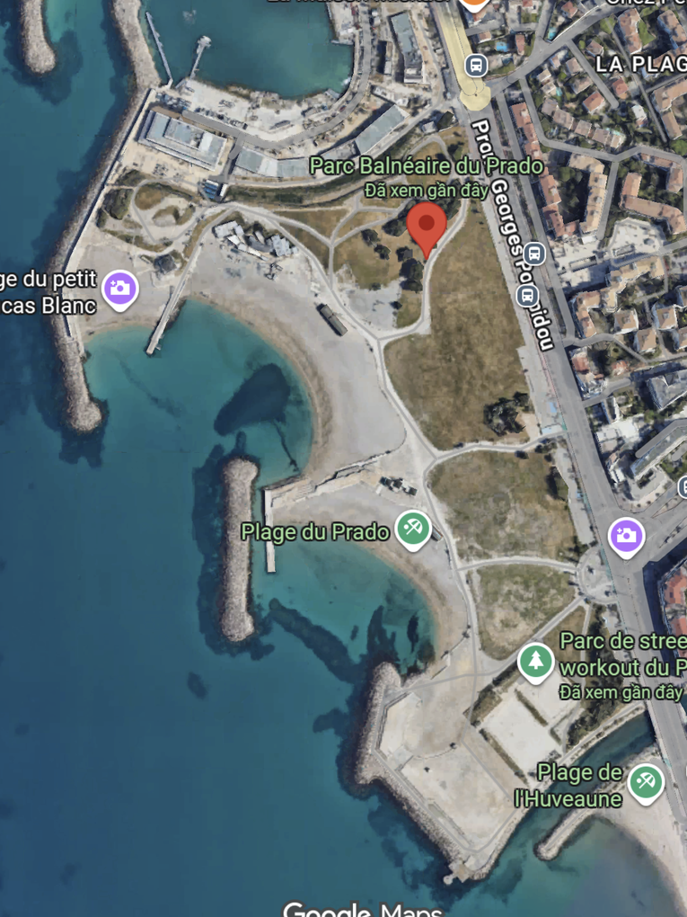


Prado Park - Parc Balnéaire du Prado
Target Audience:
  Citizens in Marseille
  Foreign tourists

Slide 8
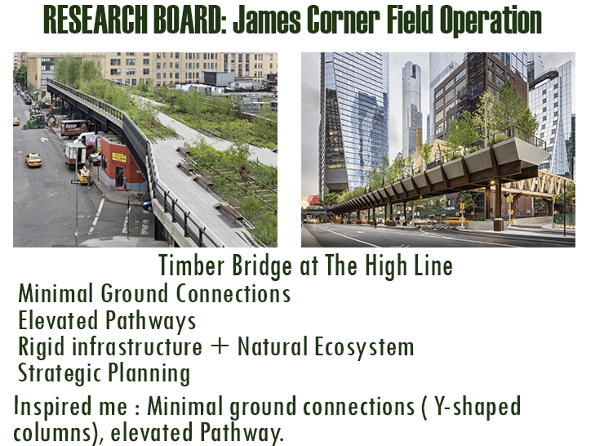
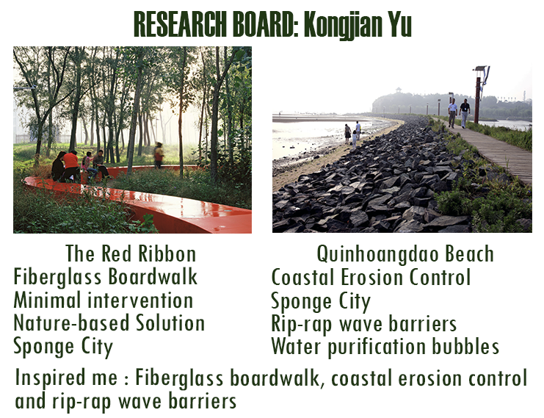
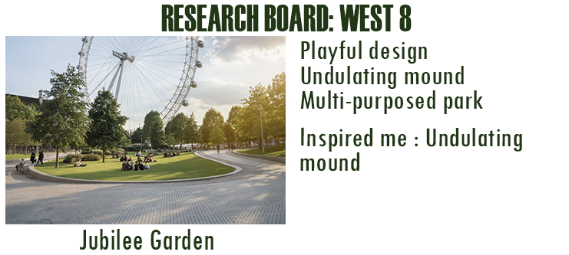
Research

Slide 9
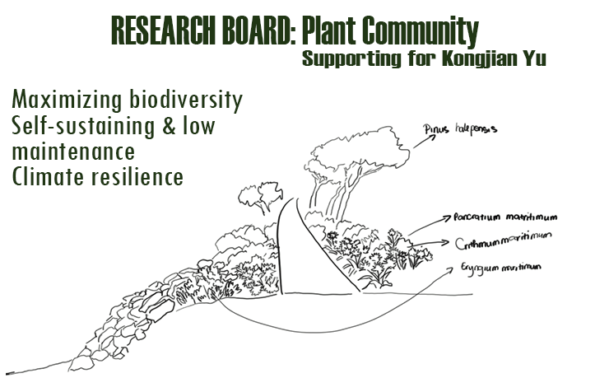

Slide 10
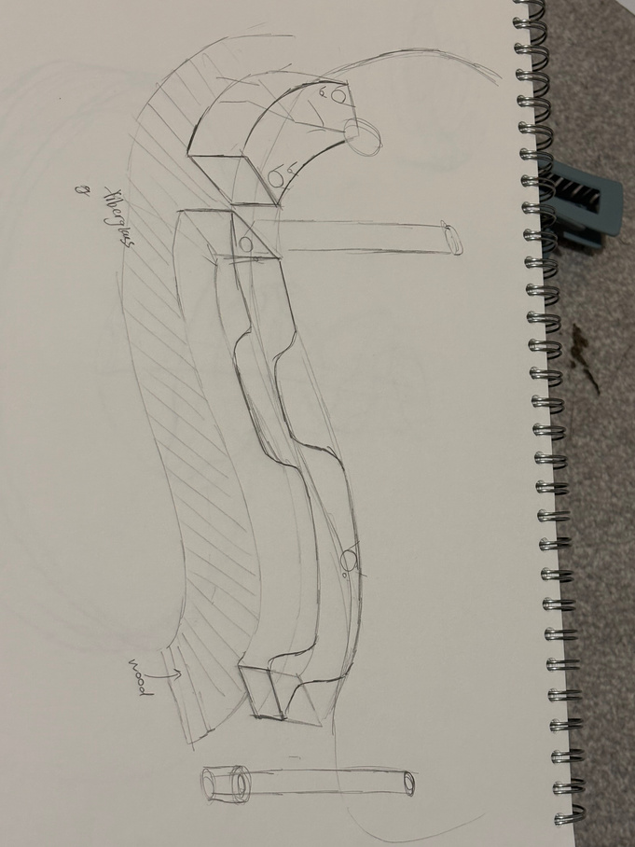
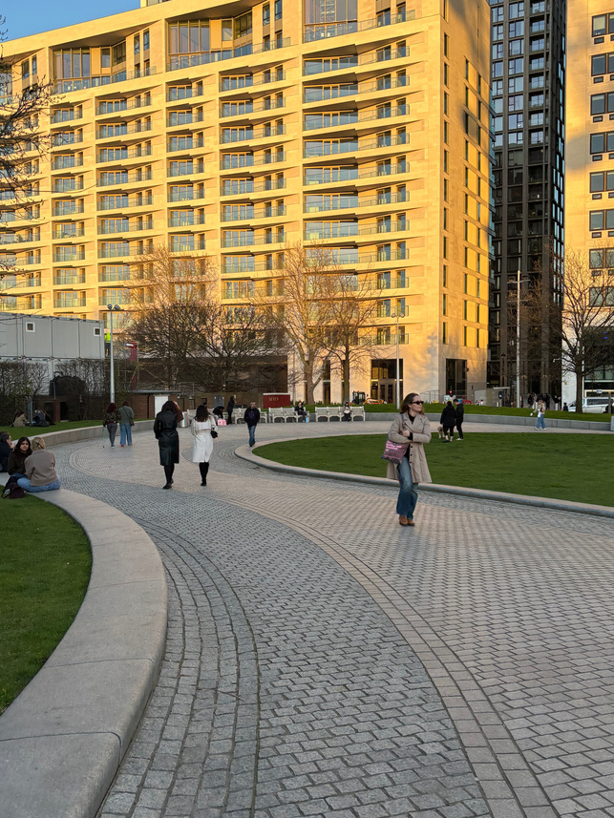
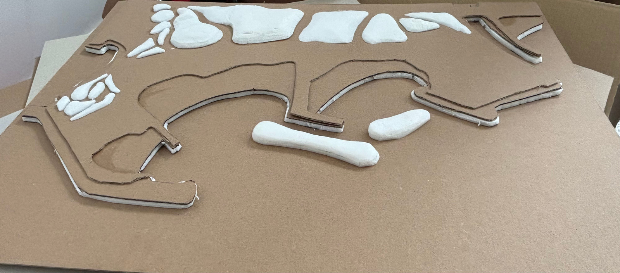
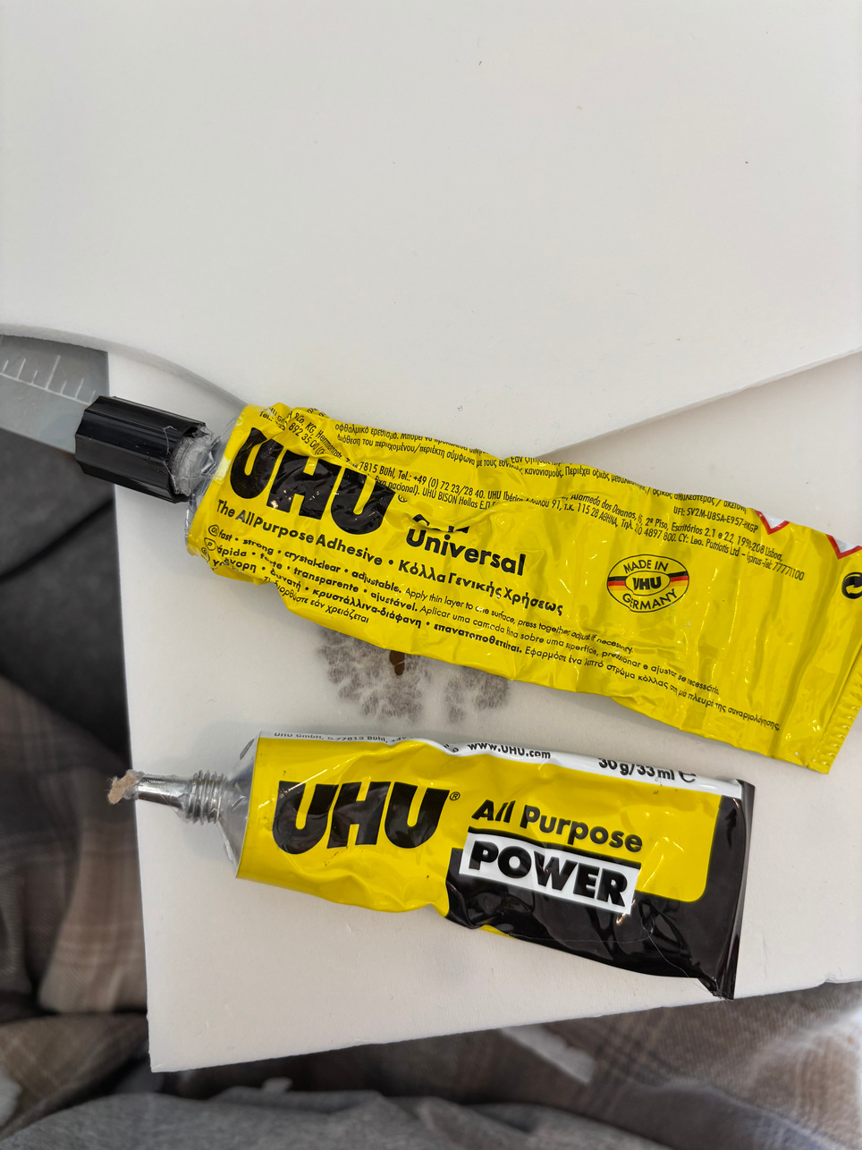
Skills learnt
  Research skills
  Model making
  Drawing skills
  Experiment with different materials

Slide 11
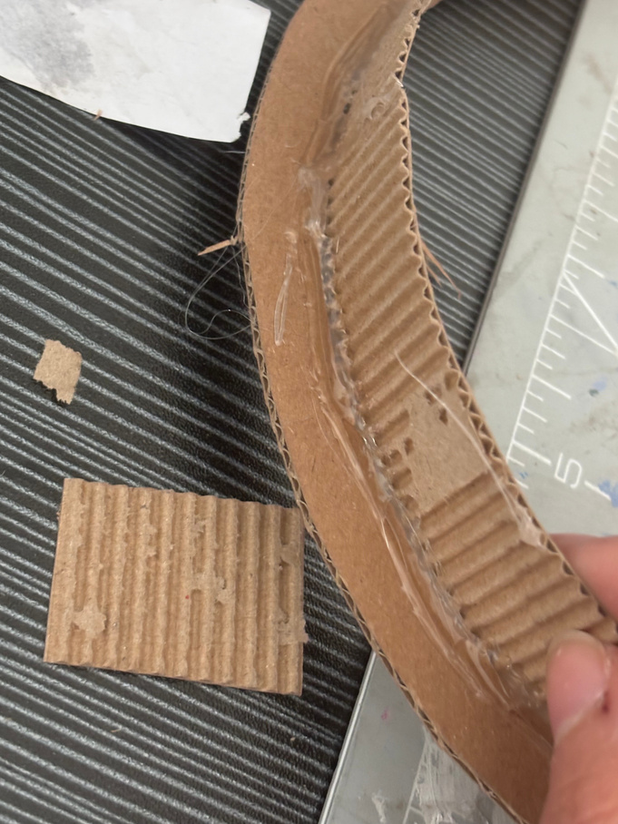
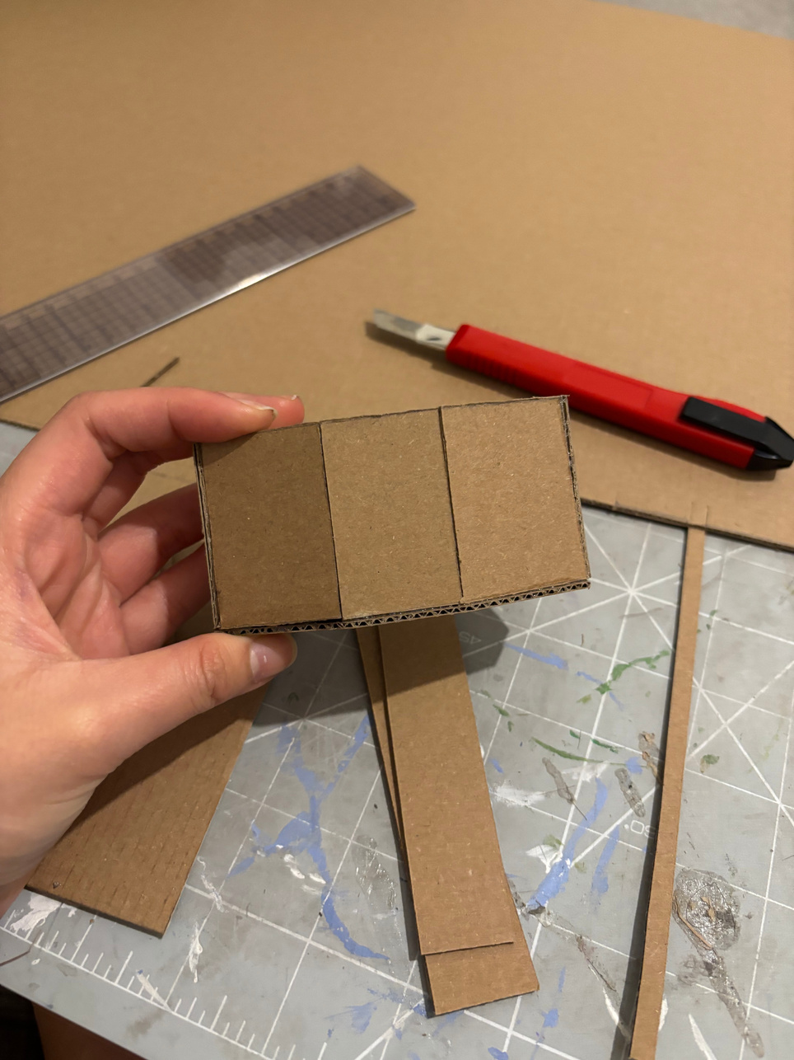
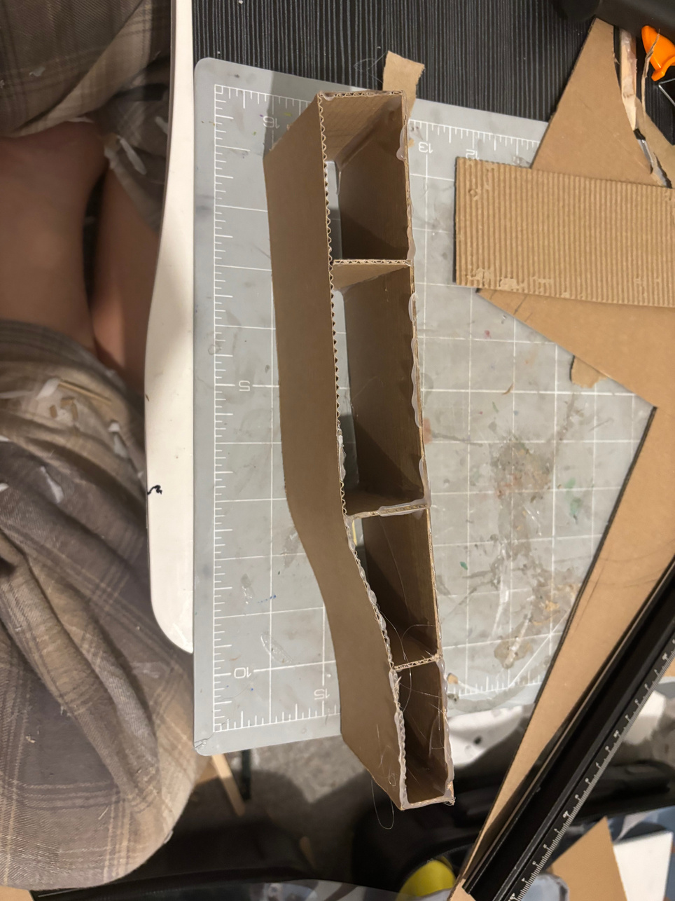
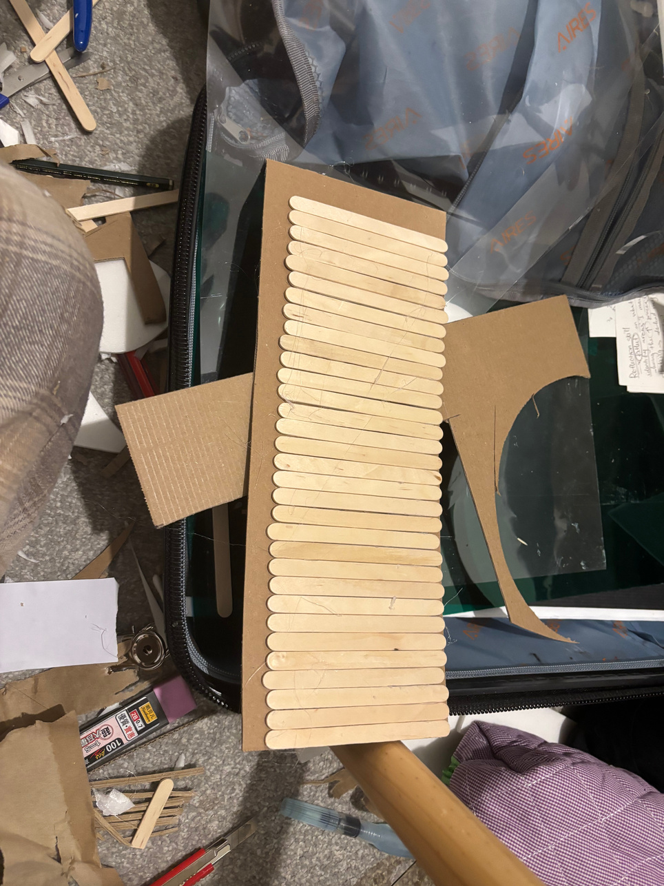
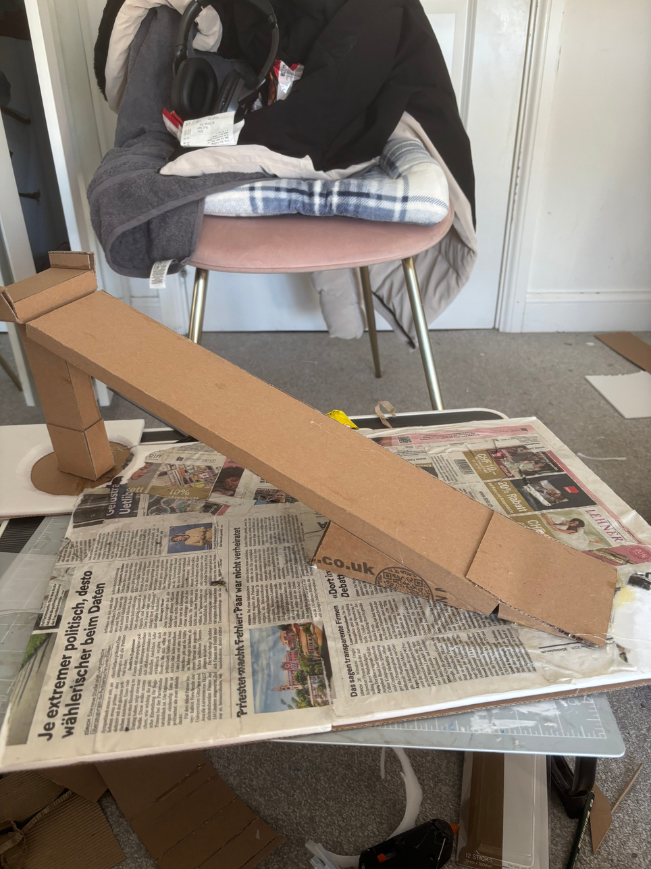
Model making

Slide 12
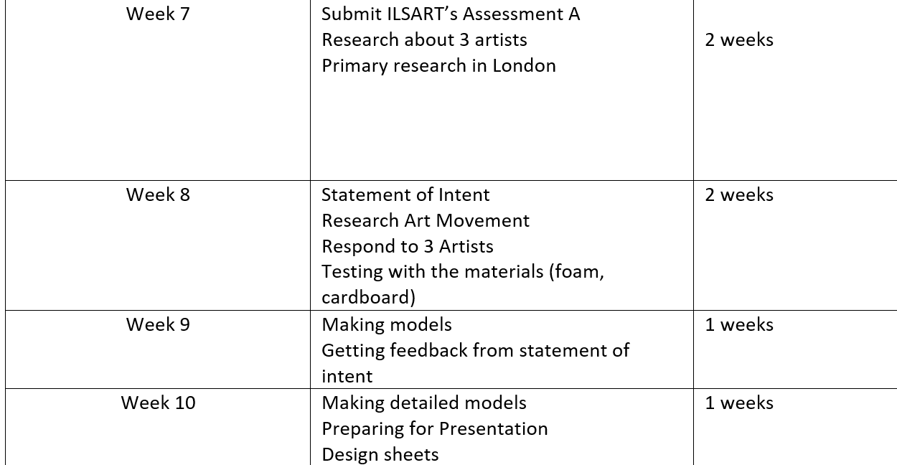
Planning
Making to-do list
Action Plan
Priority the tasks

Slide 13
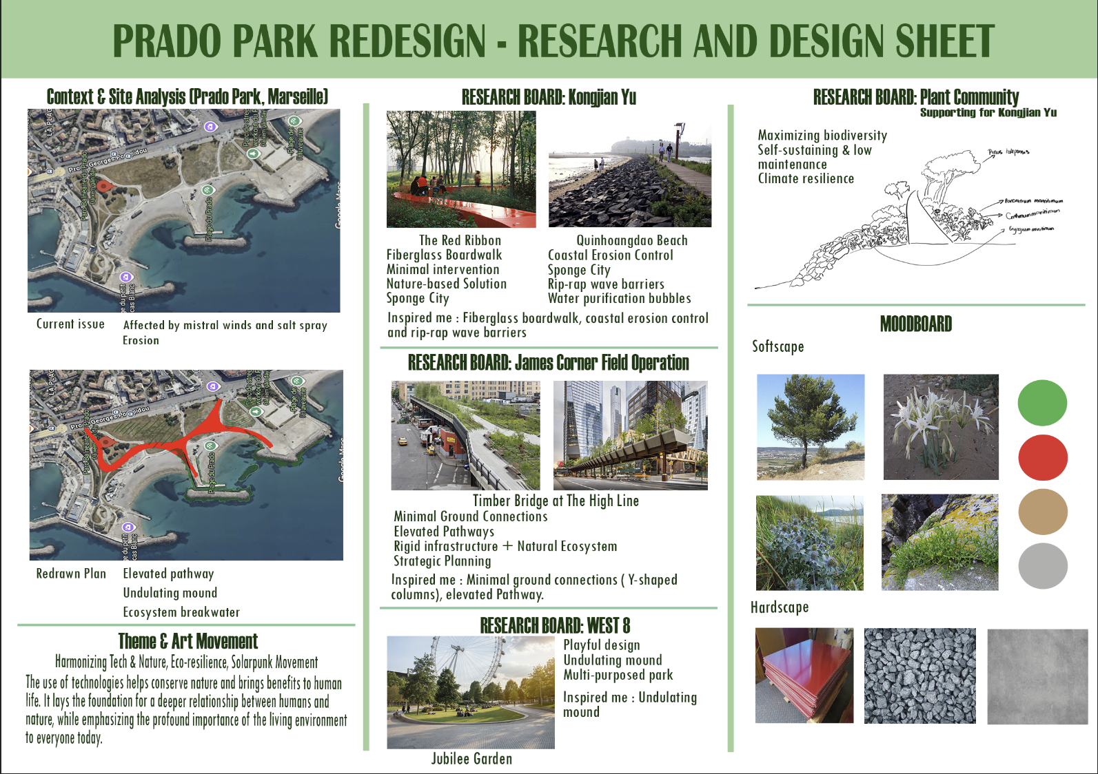

Slide 14
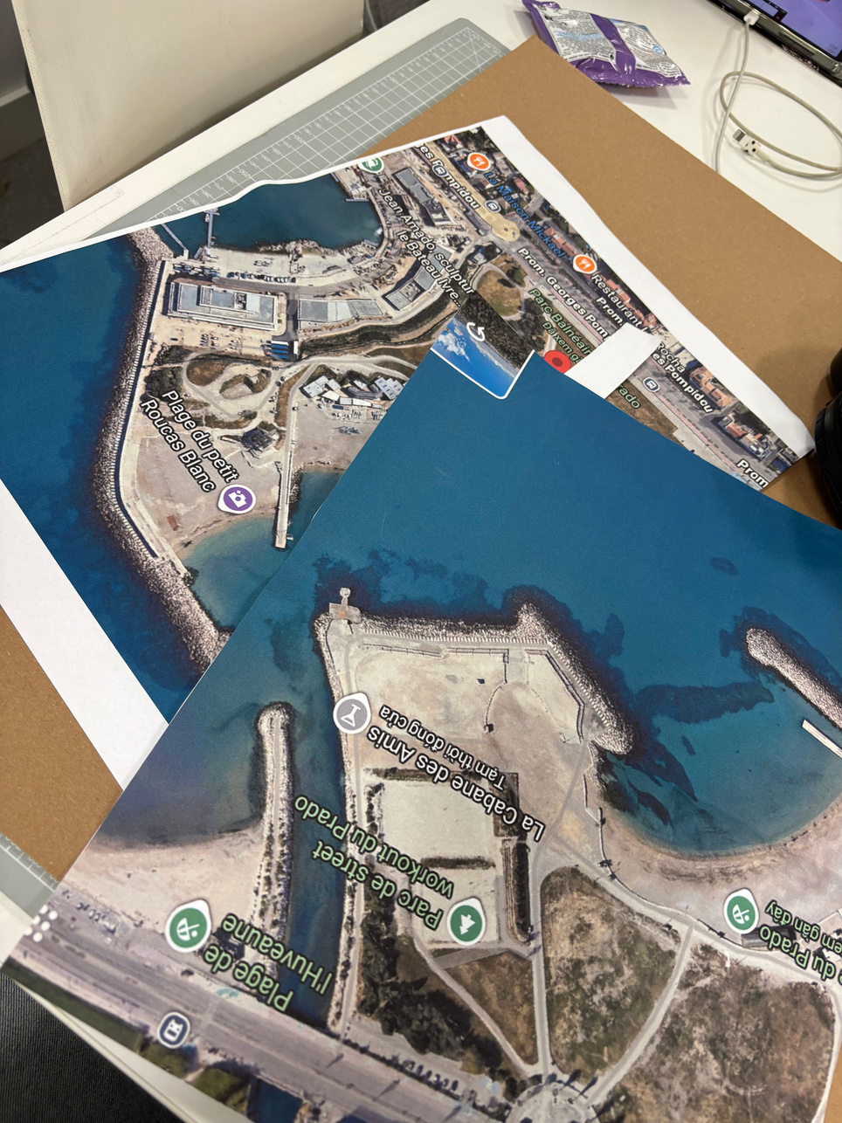
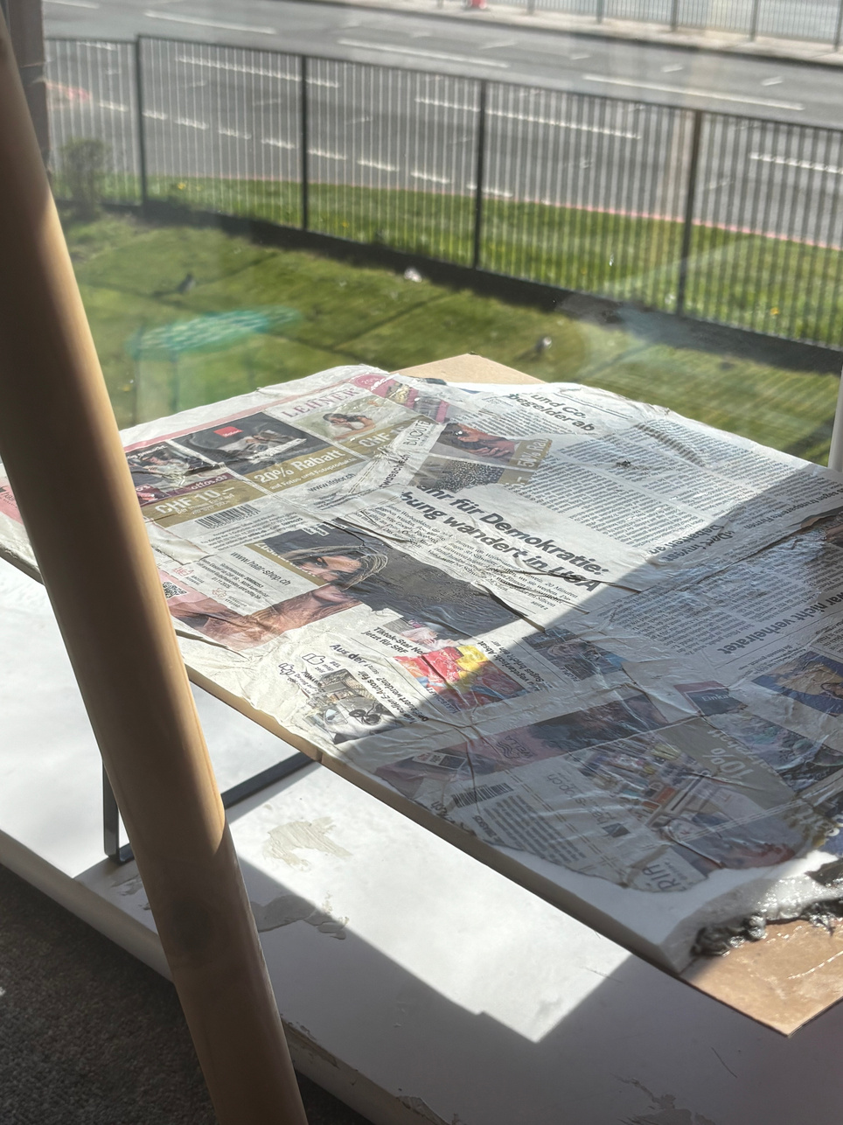
Overall Experience
Stressful
Burnout
Learn new skills
Develop my research skill

Slide 15
Reference list:
Harrouk, C. (2019). LAVA+Aspect design the Central Park of Ho Chi Minh City. [online] ArchDaily. Available at: https://www.archdaily.com/922558/lava-plus-aspect-design-the-central-park-of-ho-chi-minh-city [Accessed 10 Mar. 2026].
Florian, M.-C. (2025). Kongjian Yu, Creator of the Sponge City Concept, Passes Away in Brazil Plane Crash. [online] ArchDaily. Available at: https://www.archdaily.com/1034437/kongjian-yu-creator-of-the-sponge-city-concept-passes-away-in-brazil-plane-crash (Accessed 10 Mar. 2026).
Ghisleni, C. (2024) 'Urban Landscape as an "Art of Survival”: An interview with Kongjian Yu, the Advocate of the Sponge Cities Concept', ArchDaily, 23 June. Available at: https://www.archdaily.com/1017697/urban-landscape-as-an-art-of-survival-an-interview-with-kongjian-yu-the-advocate-of-the-sponge-cities-concept (Accessed: 10 Mar 2026).
ArchDaily (2013) 'Red Ribbon Park / Turenscape', ArchDaily, 7 November. Available at: https://www.archdaily.com/445661/red-ribbon-park-turenscape (Accessed: 15 Mar 2026).
Landezine (2012) 'The Qinhuangdao Beach Restoration by Turenscape', Landezine, 16 February. Available at: https://landezine.com/the-qinhuangdao-beach-restoration-by-turenscape/ (Accessed:15 Mar 2026).
Turenscape. (2011, August 30). The Qinhuangdao Beach Restoration by Turenscape. Landezine. https://landezine.com/the-qinhuangdao-beach-restoration-by-turenscape/
Camarero, J. J., Sánchez-Salguero, R., Ribas, M., Touchan, R., Andreu-Hayles, L., Dorado-Liñán, I., Meko, D. M. and Gutiérrez, E. (2020) 'Biogeographic, Atmospheric, and Climatic Factors Influencing Tree Growth in Mediterranean Aleppo Pine Forests', Forests, 11(7), p. 736. Available at: https://doi.org/10.3390/f11070736.
Pouris, J. and Rhizopoulou, S. (2025) 'Metabolic and Stomatal Traits of Pancratium maritimum L. (Sand Daffodil) Subjected to Induced Salinity', Stresses, 5(1), p. 14. Available at: https://doi.org/10.3390/stresses5010014.
de la Riva, E. G., Lloret, F., Pérez-Ramos, I. M., Marañón, T., Navarro-Fernández, C. M., Olmo, M. and Villar, R. (2016) 'The importance of functional diversity in the stability of Mediterranean shrubland communities after the impact of extreme climatic events', Journal of Plant Ecology, 10(2), pp. 281–293. Available at: https://doi.org/10.1093/jpe/rtw027.
Cortés-Fernández, I., Sureda, A., Adrover, M., Caprioli, G., Maggi, F., Gil-Vives, L. and Capó, X. (2022) 'Antioxidant and anti-inflammatory potential of rhizome aqueous extract of sea holly (Eryngium maritimum L.)', Ecology and Evolution, 12(7), e9164. Available at: https://doi.org/10.1002/ece3.9164.
Field Operations (no date) James Corner, FASLA, PLA. Available at: https://www.fieldoperations.net/studio/people/james-corner-fasla-pla (Accessed: 10 Mar 2026).
Mazade, K. (2023) 'SOM connects block-long glulam bridge to the High Line', Dezeen. Available at: https://www.dezeen.com/2023/05/18/som-block-long-glulam-bridge-high-line/ (Accessed: 10 Mar 2026).
Skerl, U. (2024). Office Profile: West 8. [online] Landscape Architecture Platform | Landezine. Available at: https://landezine.com/office-profile-west-8/ (Accessed 15 Mar. 2026).
Landezine (2015). Jubilee Gardens by West 8. [online] Landezine. Available at: https://landezine.com/jubilee-gardens-by-west-8/ (Accessed 15 Mar. 2026).
Reina-Rozo, J. D. (2021). Art, energy, and technology: The Solarpunk movement. International Journal of Engineering, Social Justice and Peace, 8(1), 47-60. https://doi.org/10.24908/ijesjp.v8i1.14292.(Accessed: 20 Mar 2026).
Gillam, W.J. (2023) 'A Solarpunk Manifesto: Turning Imaginary into Reality' , Philosophies, 8, article 73. Available at: https://doi.org/10.3390/philosophies8040073 (Accessed: 20 Mar 2026).
Greenroofs.com (2022). Gardens by the Bay, Supertrees. [online] Greenroofs.com. Available at: https://www.greenroofs.com/projects/gardens-by-the-bay-supertrees/ (Accessed 20 Mar. 2026).
Archdaily (2012). Gardens by the Bay / Grant Associates. [online] ArchDaily. Available at: https://www.archdaily.com/254471/gardens-by-the-bay-grant-associates (Accessed 22 Mar. 2026).
Rampal-Guiducci, J. (2024) 'Prado beaches: the City of Marseille carries out early reprofiling', Gomet', 3 March. Available at: https://gomet.net/plages-du-prado-un-reprofilage-precoce/ (Accessed: 10 Mar 2026).
City of Marseille - 6th and 8th Arrondissements (2025) 'Master plan for the development of the South Coast', Ville de Marseille. Available at: https://mairie-marseille6-8.fr/votre-mairie/actualites/plan-guide-damenagement-du-littoral-sud(Accessed: 10 Mar 2026)
Ville de Marseille (2018) Program study for the global enhancement of the Prado Seaside Park in Marseille: Phase 1 - Diagnostic study. Marseille: Ville de Marseille. (Accessed: 10 Mar 2026)

Slide 16
THANK YOU

Slide 17
QUESTIONS??

