Slide 1
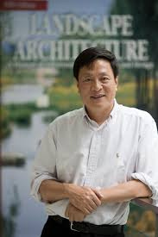

Landscape Architect
Kongjian Yu
(12/05/1963–23/09/2025)

Slide 2



1. About Kongjian Yu
CONTENT
2. Artworks

Slide 3
1

Slide 4
  Founder of the landscape architecture firm Turenscape
About
Kongjian Yu
  Advocate of the "sponge city" concept
  Nature-based solutions, such as wetlands, parks, and permeable pavements, to absorb and retain water
(12/05/1963–23/09/2025)
  The importance of landscape design for the environment, especially in the context of climate change in today's urbanized era

Slide 5
2

Slide 6
1. The red ribbon park
Artworks
2. Qinhuangdao Beach

Slide 7
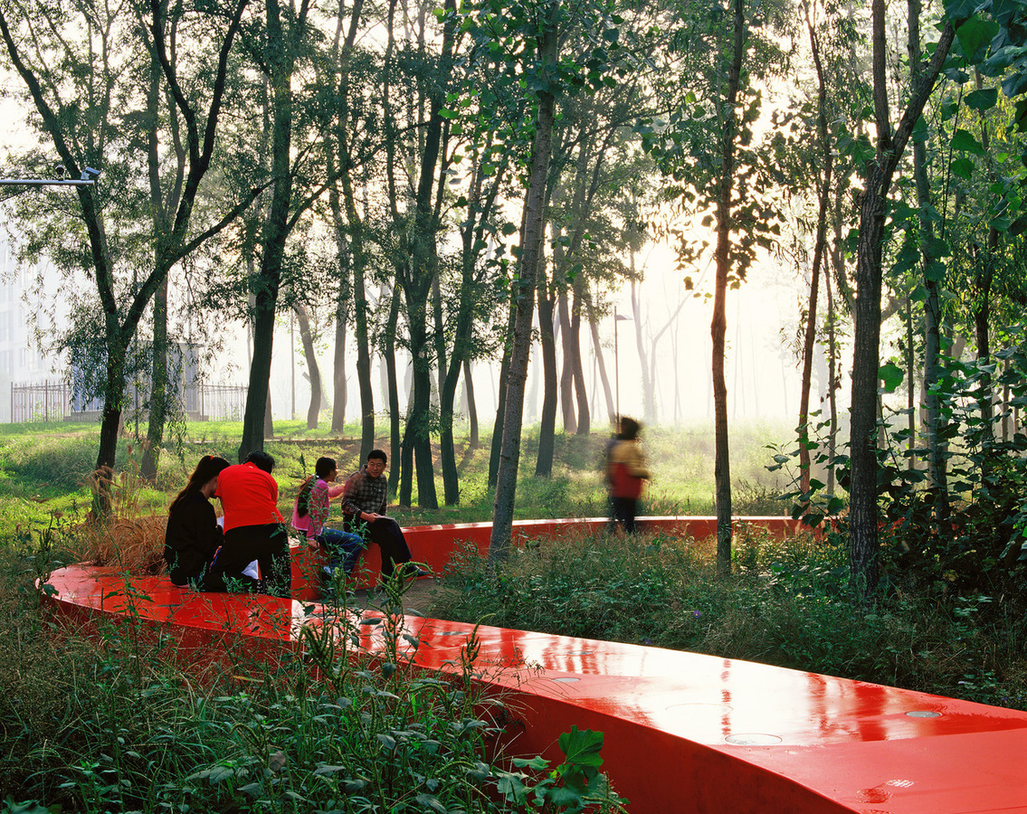

1. The red ribbon park
2007
  located in Tanghe River (Qinhuangdao, China)
  a pristine natural landscape with lush native vegetation
  a chaotic, unsafe, and unsightly area
  A red leading line extending 500 meters

Slide 8
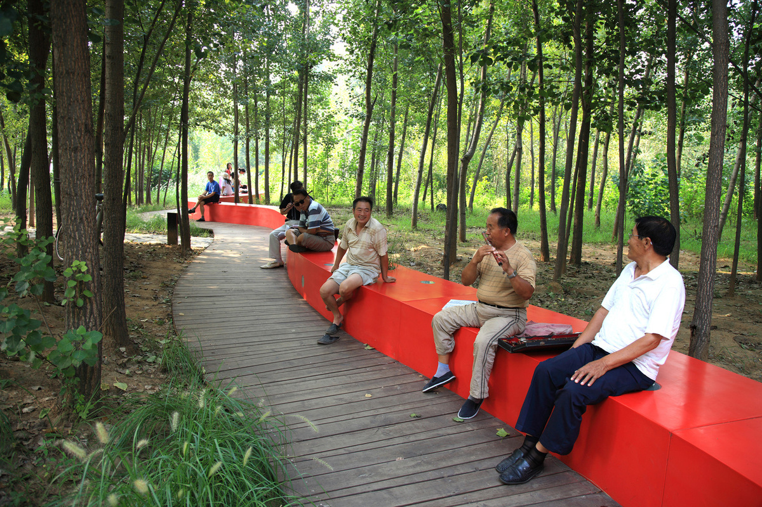
  Using red, a warm color for this line, creates a contrast point with the green color of natural vegetation
  Insteading of land reclamation or the construction of large concrete roads that would destroy the riverside ecosystem
  wooden walkways are raised off the ground to protect the vegetation below, allowing people to access nature without stepping on it

Slide 9
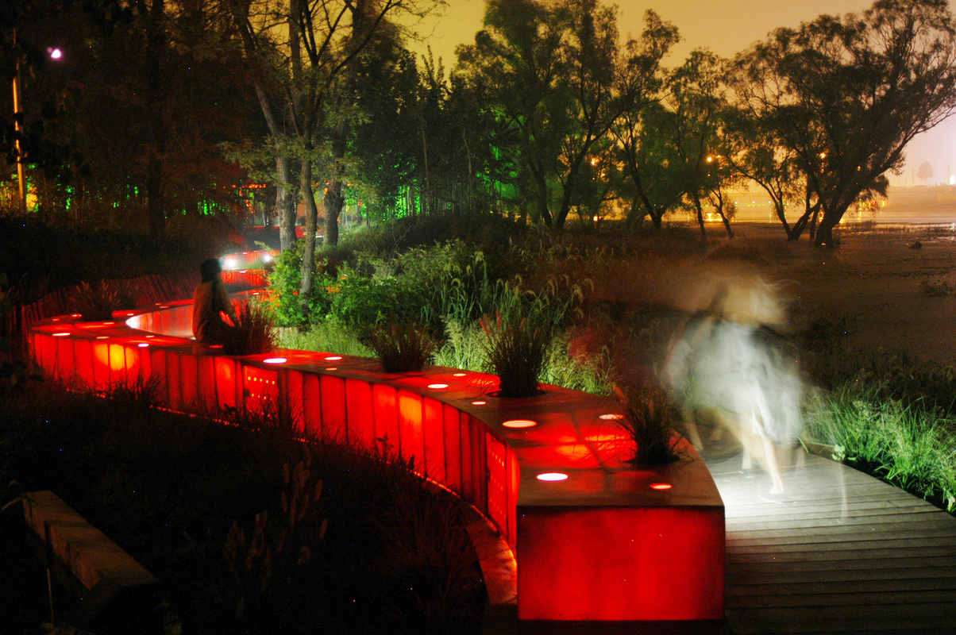
  At night, the red ribbon has an internal lighting system
  glows brightly, transforming into a warm red streak of light stretching through the darkness of the forest
  This makes the ribbon stand out and differentiate itself from the natural vegetation background
  provides sufficient light and creates a safe environment for people walking at night without erasing the peaceful atmosphere of the river

Slide 10
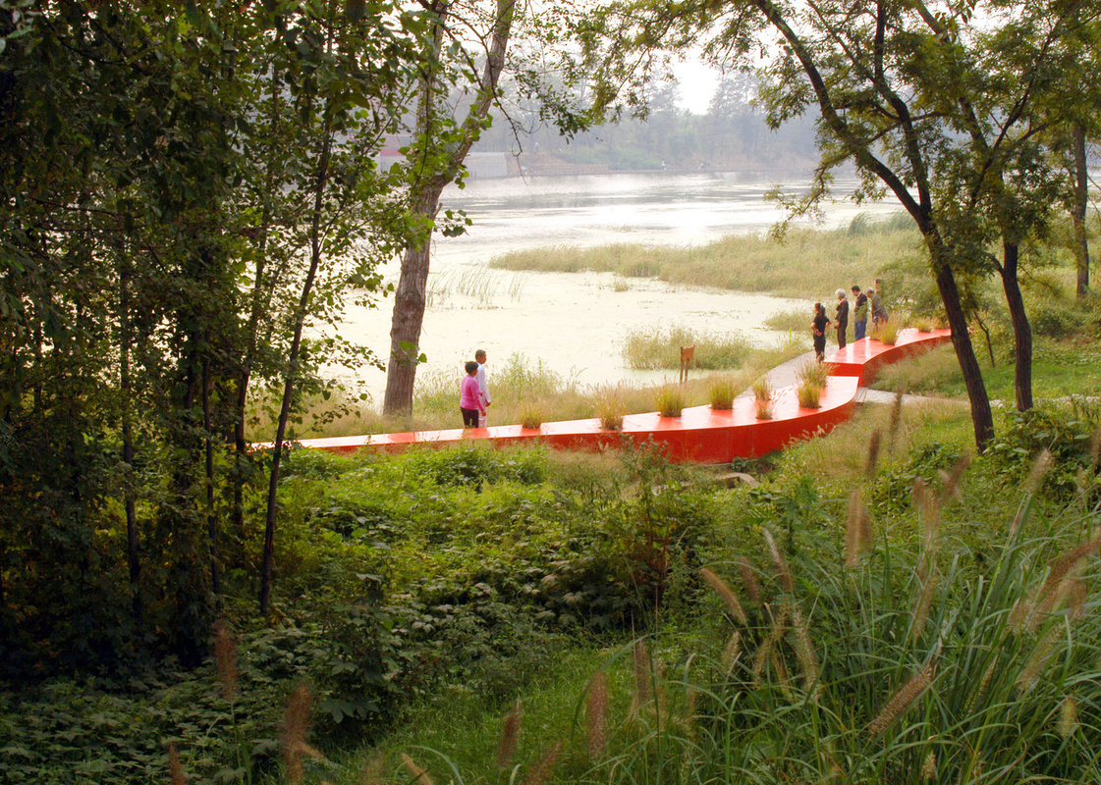
  This project solved the challenge of transforming a riverside area polluted with waste into a green, clean, and safe public space with minimal environmental impact.
  instead of simply designing landscapes to decorate the city, he makes it functional in addressing climate change issues

Slide 11
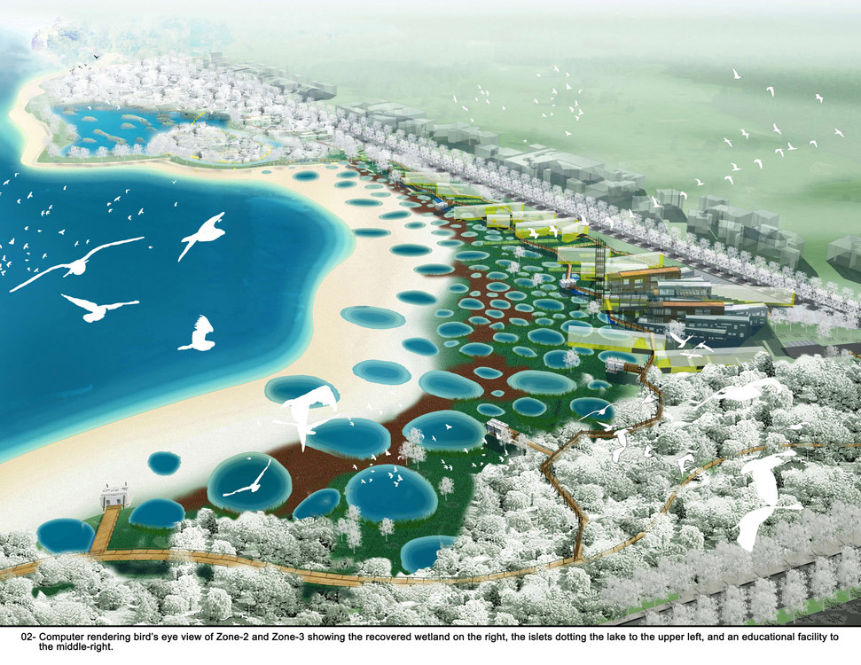
2. Qinhuangdao Beach
2008
  located on the Bohai Sea coast, a region that once suffered severe erosion, degraded vegetation, and was littered with waste due to unplanned development activities in the past

Slide 12
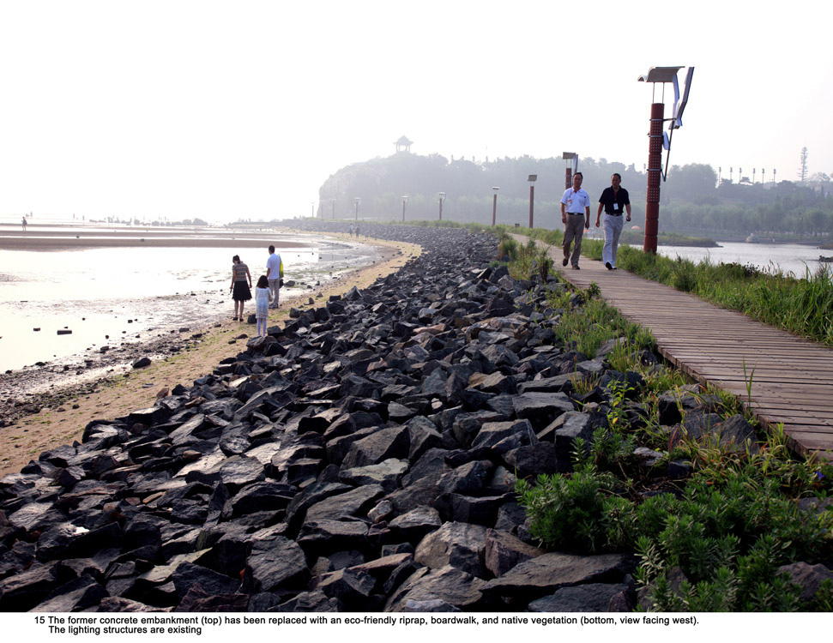
  they used a fiberglass boardwalk for people which winds along the shoreline linking different plant populations
  This helps people to experience diverse plant(softscape) communities along the way,which also serve as a soil conservation structure, protecting the coastline from erosion caused by sea winds and waves

Slide 13
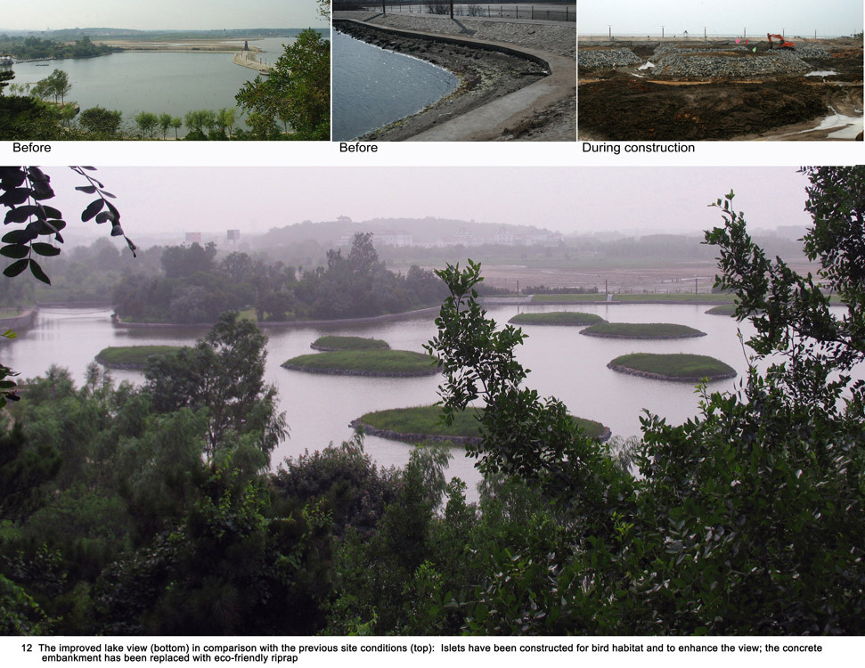
  an ecological restoration strategy on an abandoned construction site
  Utilizing construction debris to create bubble-shaped water holes is a solution for rainwater management
  transforms the site's shortcomings into microbial ecosystems, retaining natural water and creating habitats for plants and birds to recover.

Slide 14
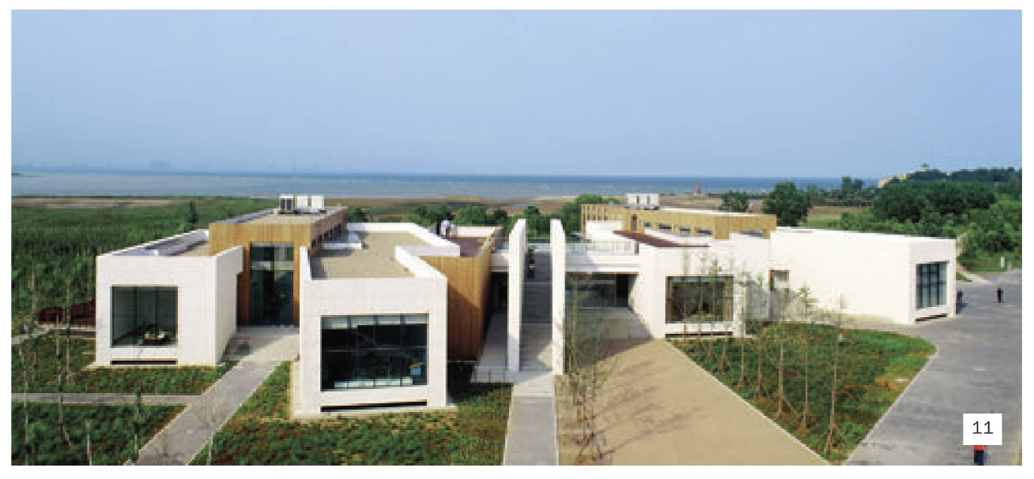
  the interplay of the building and its surroundings is inspired by the shape of boats anchored in clusters. Instead of destroying and rebuilding the landscape, they allowed the architecture to blend seamlessly with it. Furthermore, they utilized the ocean breeze to cool the building during hot summer months.

Slide 15
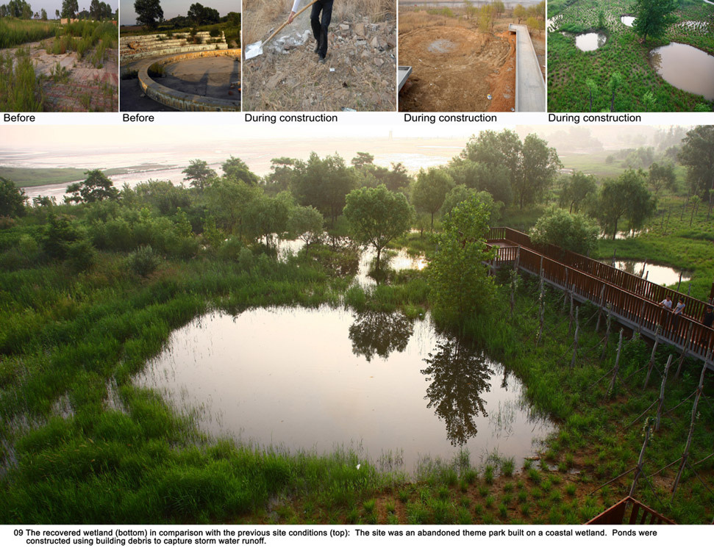
  this project has a great solution for building an erosion-resistant stone embankment for the coastal park. Integrating environmentally friendly materials and vegetation is truly a great idea, minimizing coastal erosion, providing a certain level of safety, and creating a green ecosystem for the surrounding environment in today's urbanized era.

Slide 16
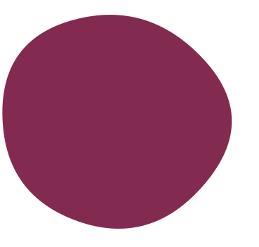


Questions???

Slide 17
Thank You!!!

