Slide 1
Mango
JOURNEY
Phuong Vi Nguyen

Slide 2
01
INTRODUCTION
LIST OF CONTENTS
02
LEARNING JOURNEY
03
CHALLENGES & PROBLEM-SOLVING
04
PROFESSIONAL PREPARATION
05
CONCLUSION

Slide 3
My feeling:
  Quiet confidence and cautious optimism because of having navigated my first semester
Introduction
  Overcome this semester smoothly.
  Having new experience
Personal goal :
  My creative thinking in landscape architecture
  Doing projects more professional
  Research skill
  Balance between creative practice and critical analysis.
  Anticipation
  Personal Goals

Slide 4
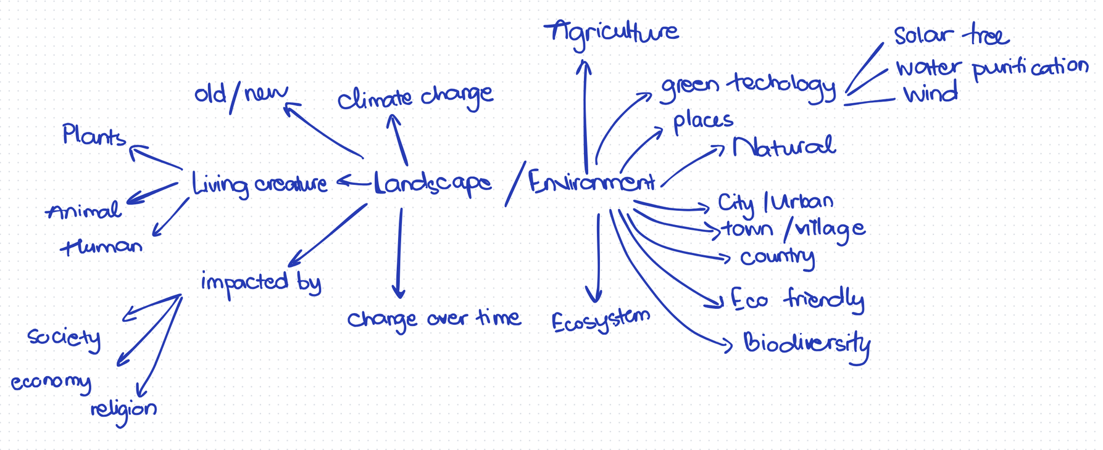
Theme: Landscape and Environment
the use of old/new technologies helps conserve nature and brings benefits to human life

Slide 5
LearningJourney
Academic Skills And Personal Skills

Slide 6
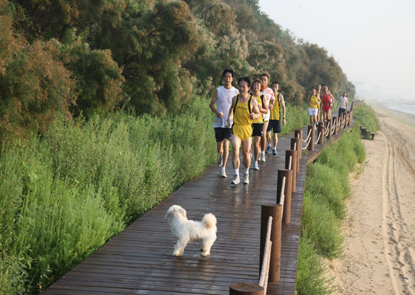
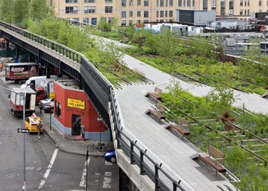
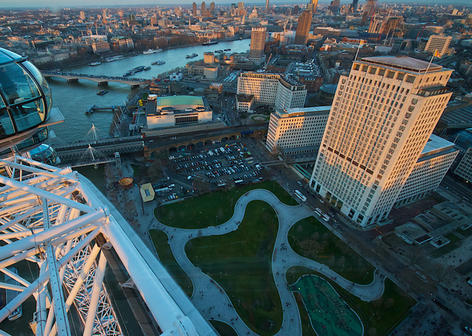
Academic Research
Kongian Yu - “sponge city” concept
James Corner Field Operation - The High Line
SKILLS
West 8 - Jubilee Garden

Slide 7
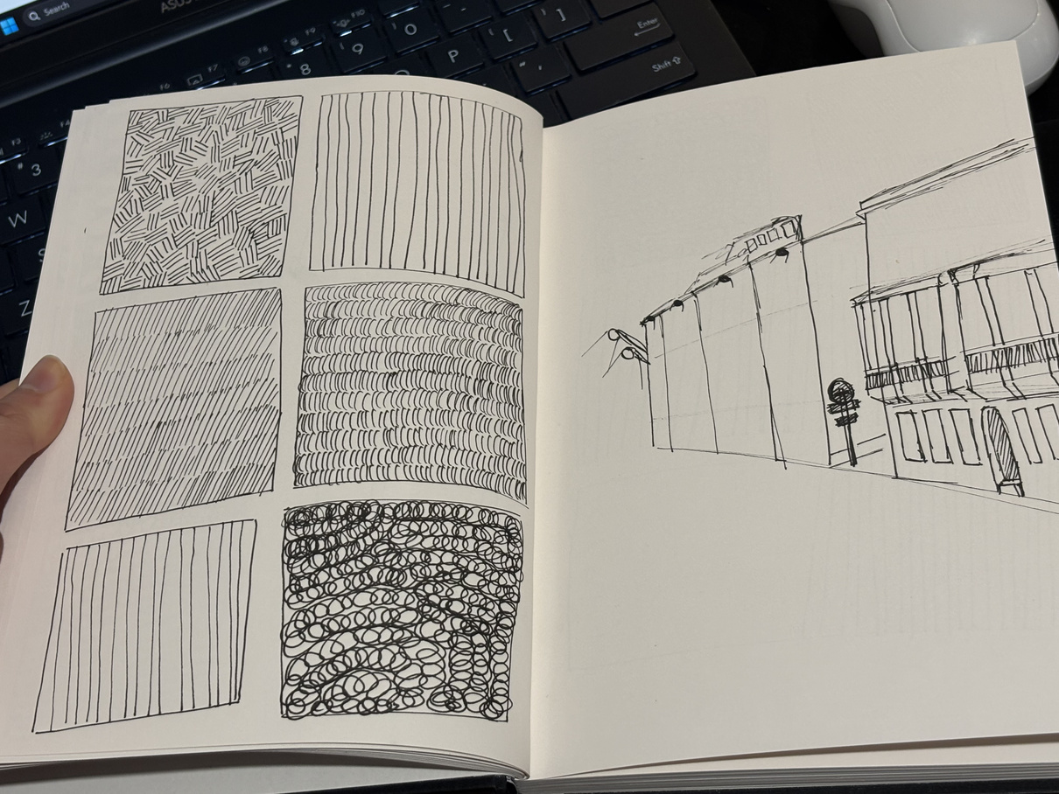
OTHER ACADEMIC
skills
  Generating idea into sketches more quickly
  Quick-skecthing
  Design Thinking
  Art Research and Critical Skills
  Connecting functionality with its real-world context
  Evaluate and compare the artworks from a wider range of perspectives.
  Reflective Practice

Slide 8
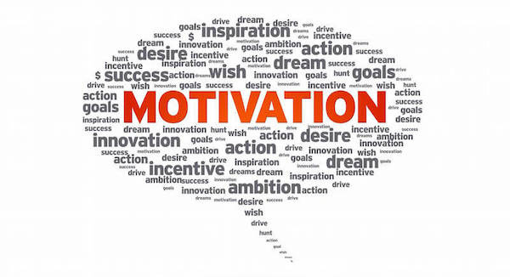
Personal
SKILLS
  Time Management
  Money Management
  Motivating Myself

Slide 9



CHALLENGES
Time Management
Academic Pressure
Self Pressure
Burnout

Slide 10
  discussing with my tutor, my friends and asking suggestions from higher level students
Create a to-do list and set reasonable time limits for each task.
Time Management
Divide tasks appropriately.
Problem
Cannot solve 100% of these problems
Academic pressure and self-pressure
Reducing the expectation on myself
SOLVING
Refer the experiece than the grade
Watching self-help topics
Burnout
Get enough rest

Slide 11
Reflection skill - It helps me reflect on what I have done and identify areas I may have overlooked during the development process. It supports critical thinking, which will help me defend my projects in the future.
Professional
Time Management - Balance research, sketching, modeling, and essay writing. Having a contingency plan is a good idea, allowing me to complete my assignment on time.
PREPARATION
Communication Skills - Generating idea into speech in an easy-to-understand way for other

Slide 12

CONCLUSION
This semester has been much more than just an academic step; it is a personal transformation.
The most significant discovery I made is the power of Resilience.
Looking ahead to Year 1, I want myself to have enough skills to be a good landscape architecture student.

Slide 13
REFERENCES:
+ Richards, J. (2013) Freehand drawing and discovery: urban sketching and concept drawing for designers. 1st edition. Hoboken, NJ: WILEY.89
+Florian, M.-C. (2025). Kongjian Yu, Creator of the Sponge City Concept, Passes Away in Brazil Plane Crash. [online] ArchDaily. Available at: https://www.archdaily.com/1034437/kongjian-yu-creator-of-the-sponge-city-concept-passes-away-in-brazil-plane-crash [Accessed 10 Mar. 2026].
+Mazade, K. (2023) SOM connects block-long glulam bridge to the High Line. [online] Dezeen. Available at: https://www.dezeen.com/2023/05/18/som-block-long-glulam-bridge-high-line/ [Accessed: 15 Mar. 2026]
+Landezine (2015). Jubilee Gardens by West 8. [online] Landezine. Available at: https://landezine.com/jubilee-gardens-by-west-8/ [Accessed 15 Mar. 2026].

Slide 14
THANK YOU

Slide 15
QUESTIONS??

