Slide 1
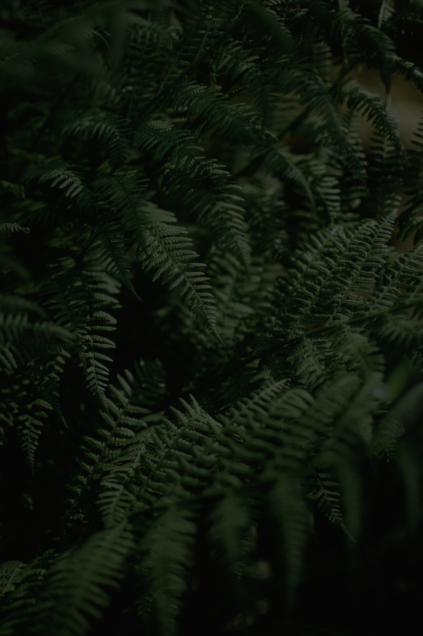
MANGO
ECO-ART
PRESENTATION

Slide 2
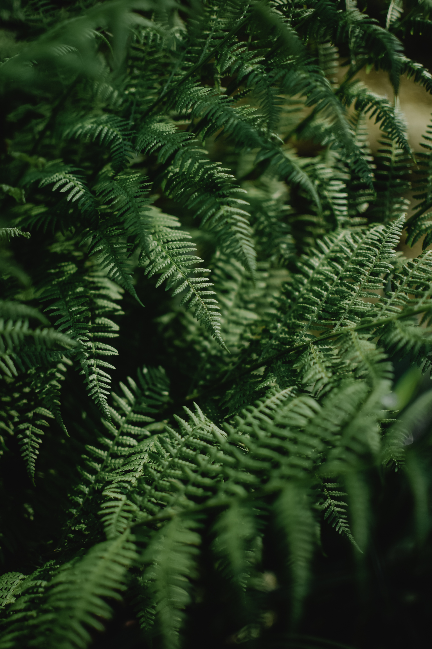
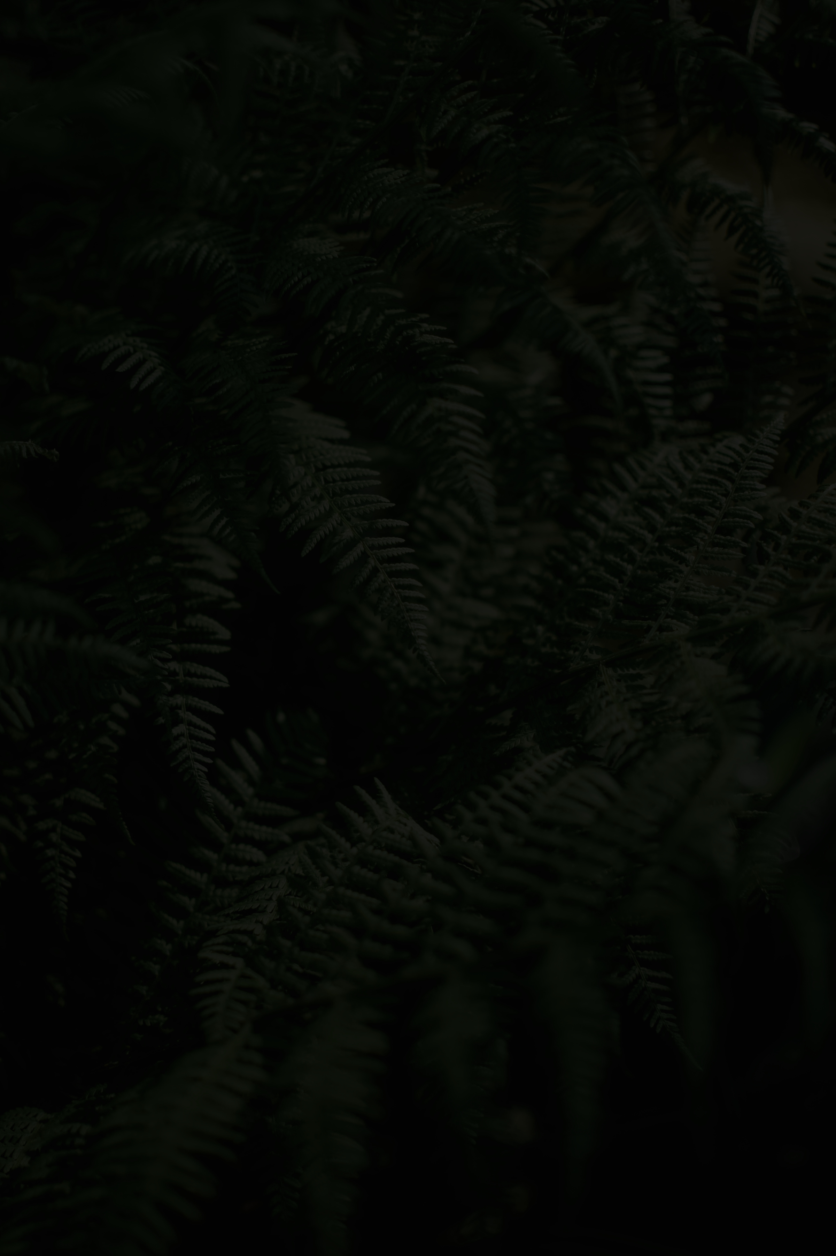
Eco-art is an art movement which includes a wide range of artistic expressions that explore and respond to the environment issue, climate change, and ecological sustainability.
Eco Art is a contemporary art movement that focuses on the network of interdependent relationships within our living environment. The term emerged in the 1990s to describe artistic practices that had begun to take shape in the late 1960s. The movement's core objective is not merely to reflect nature, but to directly rehabilitate, restore, and heal damaged environments.
WHAT IS AN
ECO ART??

Slide 3
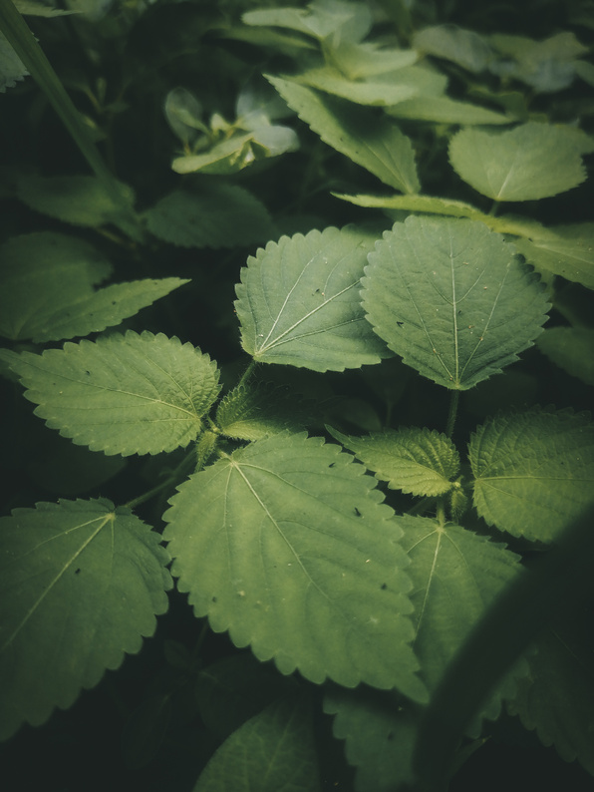
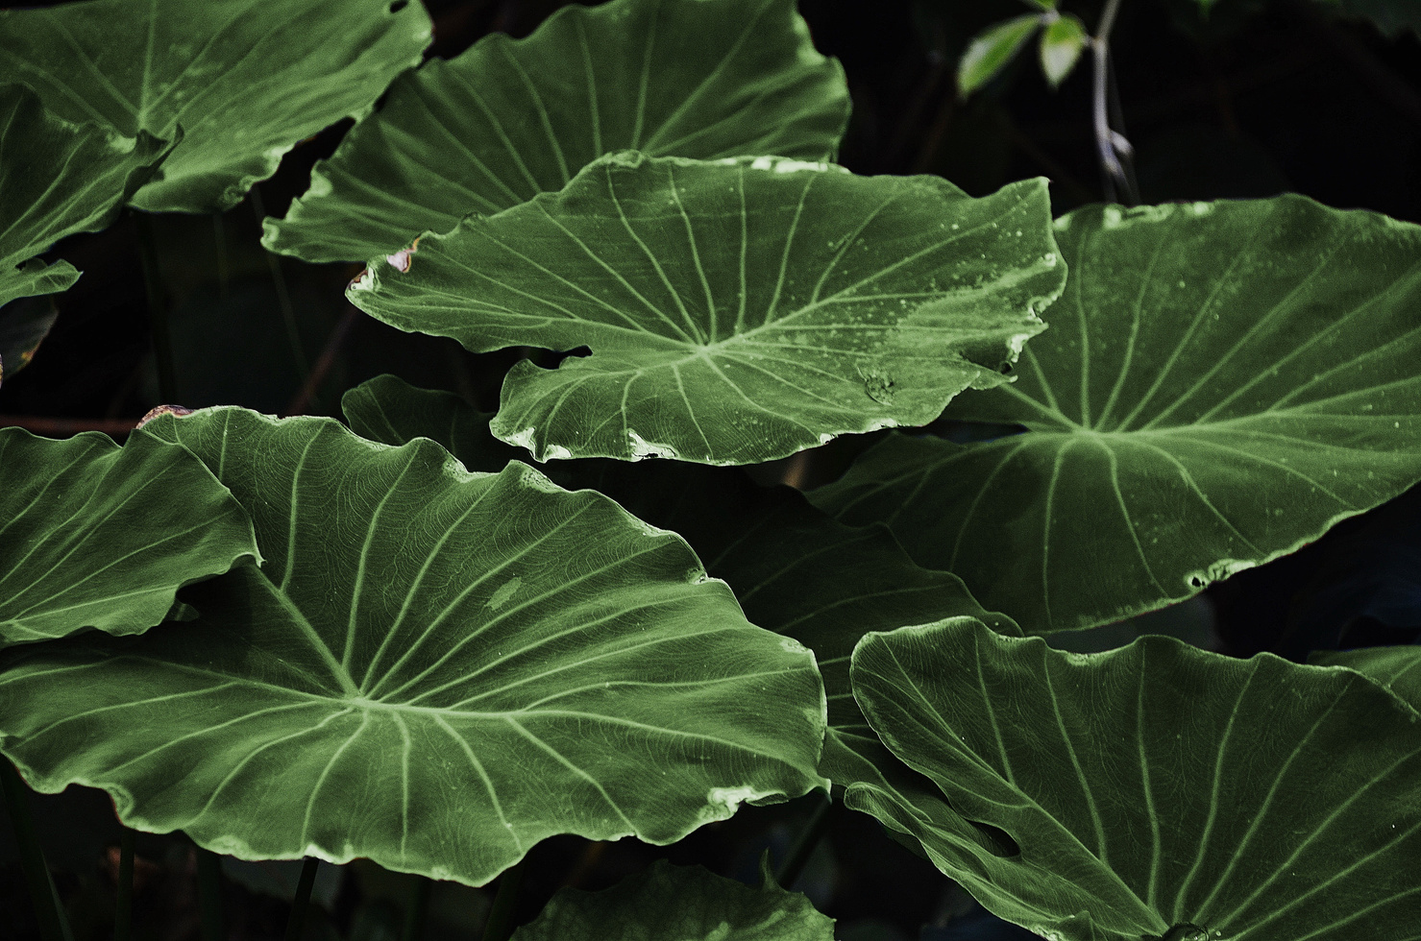
2. WHAT ARE THE CHARACTERISTICS OF THE MOVEMENT?
  Eco-art focuses on the web of interdependent relationships within the environment, encompassing the physical, biological, cultural, political, and historical aspects of ecosystems.
  Artists often utilize natural materials or engage directly with environmental forces such as wind, water, or sunlight. The resulting works aim to rehabilitate, restore, and heal environments that have been damaged.
  Eco-art serves to inform the public about ecological dynamics and the environmental challenges we face.
  These practices help reimagine ecological relationships, thereby proposing new possibilities for coexistence, sustainability, and healing.

Slide 4
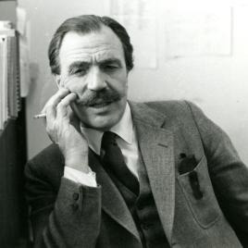
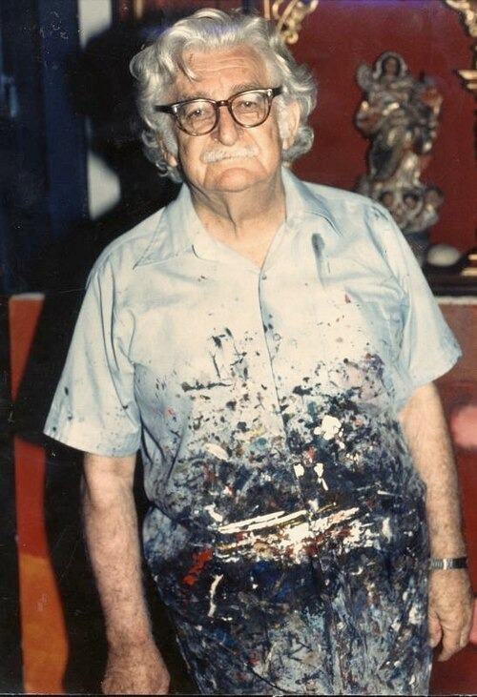
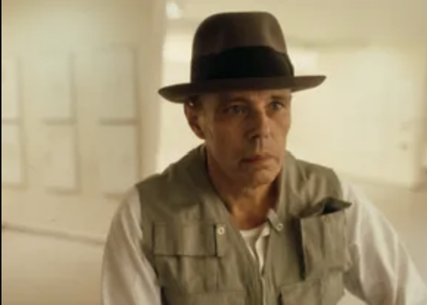
  Ian McHard (1920-2001)
  Roberto Burle Marx (1909-1994)
  Joseph Beuys (1921-1986)

Slide 5
  Scottish landscape architect, planner, and educator, best known for his landmark book Design With Nature (1969). Founder of the Department of Landscape Architecture at the University of Pennsylvania
  Technique: popularized ecological planning as a method integrating natural systems into design. McHarg’s method prefigured GIS, mapping soil, hydrology, and vegetation to guide planning decisions.
IAN MCHARG (1920-2001)

Slide 6
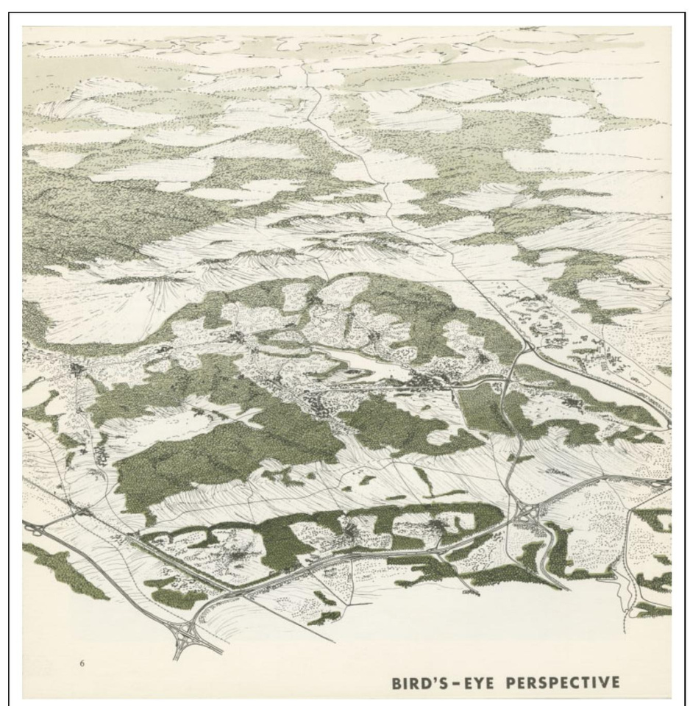
THE PLAN FOR THE VALLEYS (1964):
  Employed a method the termed "ecological determinism" to guide spatial design
  This process involved a rigorous inventory of natural processes,including hydrology, soils, geology, and meteorology, to identify optimal locations for both land development and conservation
  He used topographic and hydrological maps for zoning, preserving valley spaces and primary forests as "green infrastructure”.

Slide 7
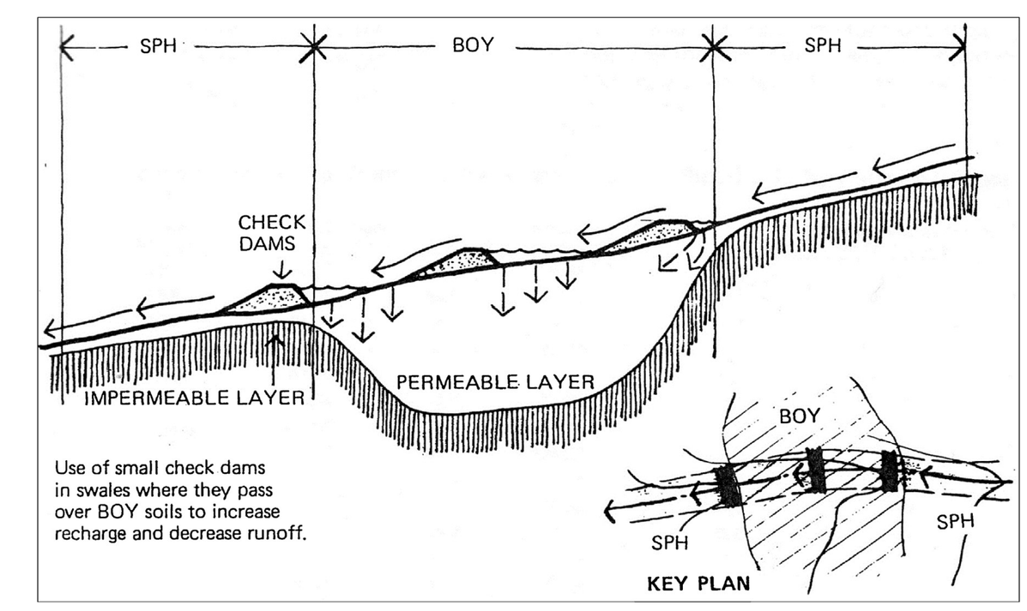
THE WOODLANDS (1970)
  A project to plan a new urban community on the wetlands north of Houston, USA.
  McHarg identified the natural hydrological system as the area's backbone. He retained the existing ditches and vegetation to serve as an ecological drainage system, effectively mitigating surface runoff and controlling flooding.
  The design process employed the layer-cake mapping model to determine land suitability and address highly interconnected regional issues, such as aquifer recharge and flood mitigation.

Slide 8
  a Brazilian landscape architect, artist, and ecologist who introduced modernist landscape architecture to Brazil. A pioneer of rainforest conservation, he discovered and cultivated many plant species, some of which bear his name.
ROBERTO BURLE MARX (1909-1994)

Slide 9
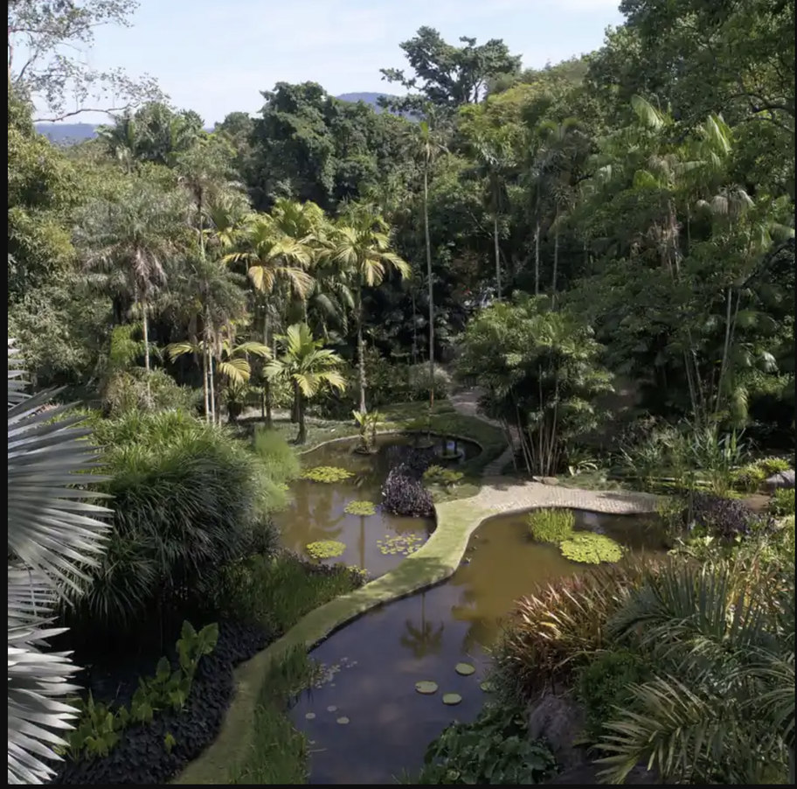
SÍTIO ROBERTO BURLE MARX (RIO DE JANEIRO, BRAZIL):
  His own vast estate (now a UNESCO World Heritage Site), where he cultivated and studied over 3,500 species of tropical plants.
  "living ecological laboratory."
  At a time when Brazilian landscape architecture was dominated by exotic species imported from Europe, Burle Marx completely transformed the prevailing ideology by pioneering the preservation of native tropical flora.
  The form of the urban area is entirely molded and defined by this void, creating a truly organic structure.

Slide 10
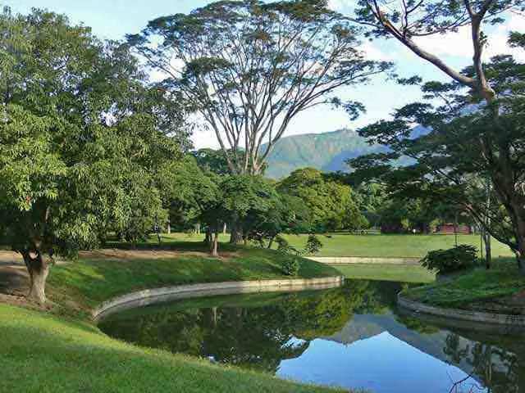
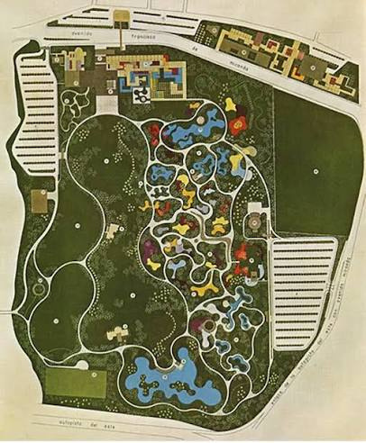
PARQUE DEL ESTE (CARACAS, VENEZUELA):
  A 200-acre public park that blends vibrant swaths of native tropical plants with geometric courtyard spaces.
  The project combines structural forms such as courtyards and reflecting pools with a "color-blocking" approach to vegetation layout. Rather than scattering plants, the designer grouped them by species into large masses to create a powerful visual impact.

Slide 11

  an German artist, teacher and political leader, recognized as having influenced everything from photography and sculpture to performance and environmental art.
  JOSEPH BEUYS (1921-1986):

Slide 12

7000 OAKS (KASSEL, GERMAN, 1982):
  Beuys and volunteers planted 7,000 oak trees throughout the city of Kassel, each paired with a basalt stone.
  This work stands as the most iconic example of Eco-art. The combination of static, inorganic material (basalt) and the natural life cycle of growth (oak trees) represents a non-linear approach to reshaping space.
  The piece dissolves the boundaries of the gallery, transforming the entire urban infrastructure into a healing process that spans generations.

Slide 13
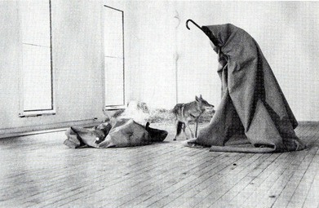
I LIKE AMERICA AND AMERICA LIKES ME (NEW YORK, USA, 1974):
  Beuys confined himself in a room at the René Block Gallery with a wild coyote for three consecutive days.
  Although a work of performance art, this piece serves as a profound ecological critique of modern civilization’s dominance over the wild natural world. The wolf represents the indigenous ecosystem devastated by urban development.
  Through his attempt to coexist peacefully with the animal, Beuys alludes to efforts to "heal" ecological ruptures and calls for a mindset of reciprocity that respects the boundaries of non-human communities.

Slide 14
  Centre, U.W.H. (2021). Sítio roberto burle marx. [online] UNESCO World Heritage Centre. Available at: https://whc.unesco.org/en/list/1620/ [Accessed 19 July 2026].
  Daryna Markova (2025). Eco-Art: Transforming awareness through creativity. [online] Domartresidence.com. DOM Art Residence. Available at: https://domartresidence.com/blog/eco-art [Accessed 19 July 2026].
  Hundt, G. and Daniels, T.L. (2016). The plan for the valleys. Journal of Planning history, 17(1), pp.3–19. doi:10.1177/1538513216681586.
  Kagan, S. (2014). The practice of ecological art.
  Landezine (2024a). Landscape architecture platform | landezine. [online] Landscape Architecture Platform | Landezine. Available at: https://landezine.com/topics/thinkers-practitioners/ian-mcharg/ [Accessed 19 July 2026a].
  Landezine (2024b). Landscape architecture platform | landezine. [online] Landscape architecture platform | landezine. Available at: https://landezine.com/topics/thinkers-practitioners/roberto-burle-marx/ [Accessed 20 July 2026b].
  National Gallery of Canada (2017). Joseph Beuys. [online] National Gallery of Canada. Available at: https://www.gallery.ca/beuys [Accessed 19 July 2026].
  Olivier, B. (2007). Ecological “art” and the transformation of the world. South African Journal of Art History, 22, pp.24–34.
  Whitaker, W. and Steiner, F. (2019). Ian l. McHarg: An illustrated chronology of his life. Socio-Ecological practice research, 1(3–4), pp.371–380. doi:10.1007/s42532-019-00032-4.
  Yang, B. and Li, S. (2016). Design with nature: Ian McHarg’s ecological wisdom as actionable and practical knowledge. Landscape and urban planning, 155, pp.21–32. doi:10.1016/j.landurbplan.2016.04.010.

Slide 15
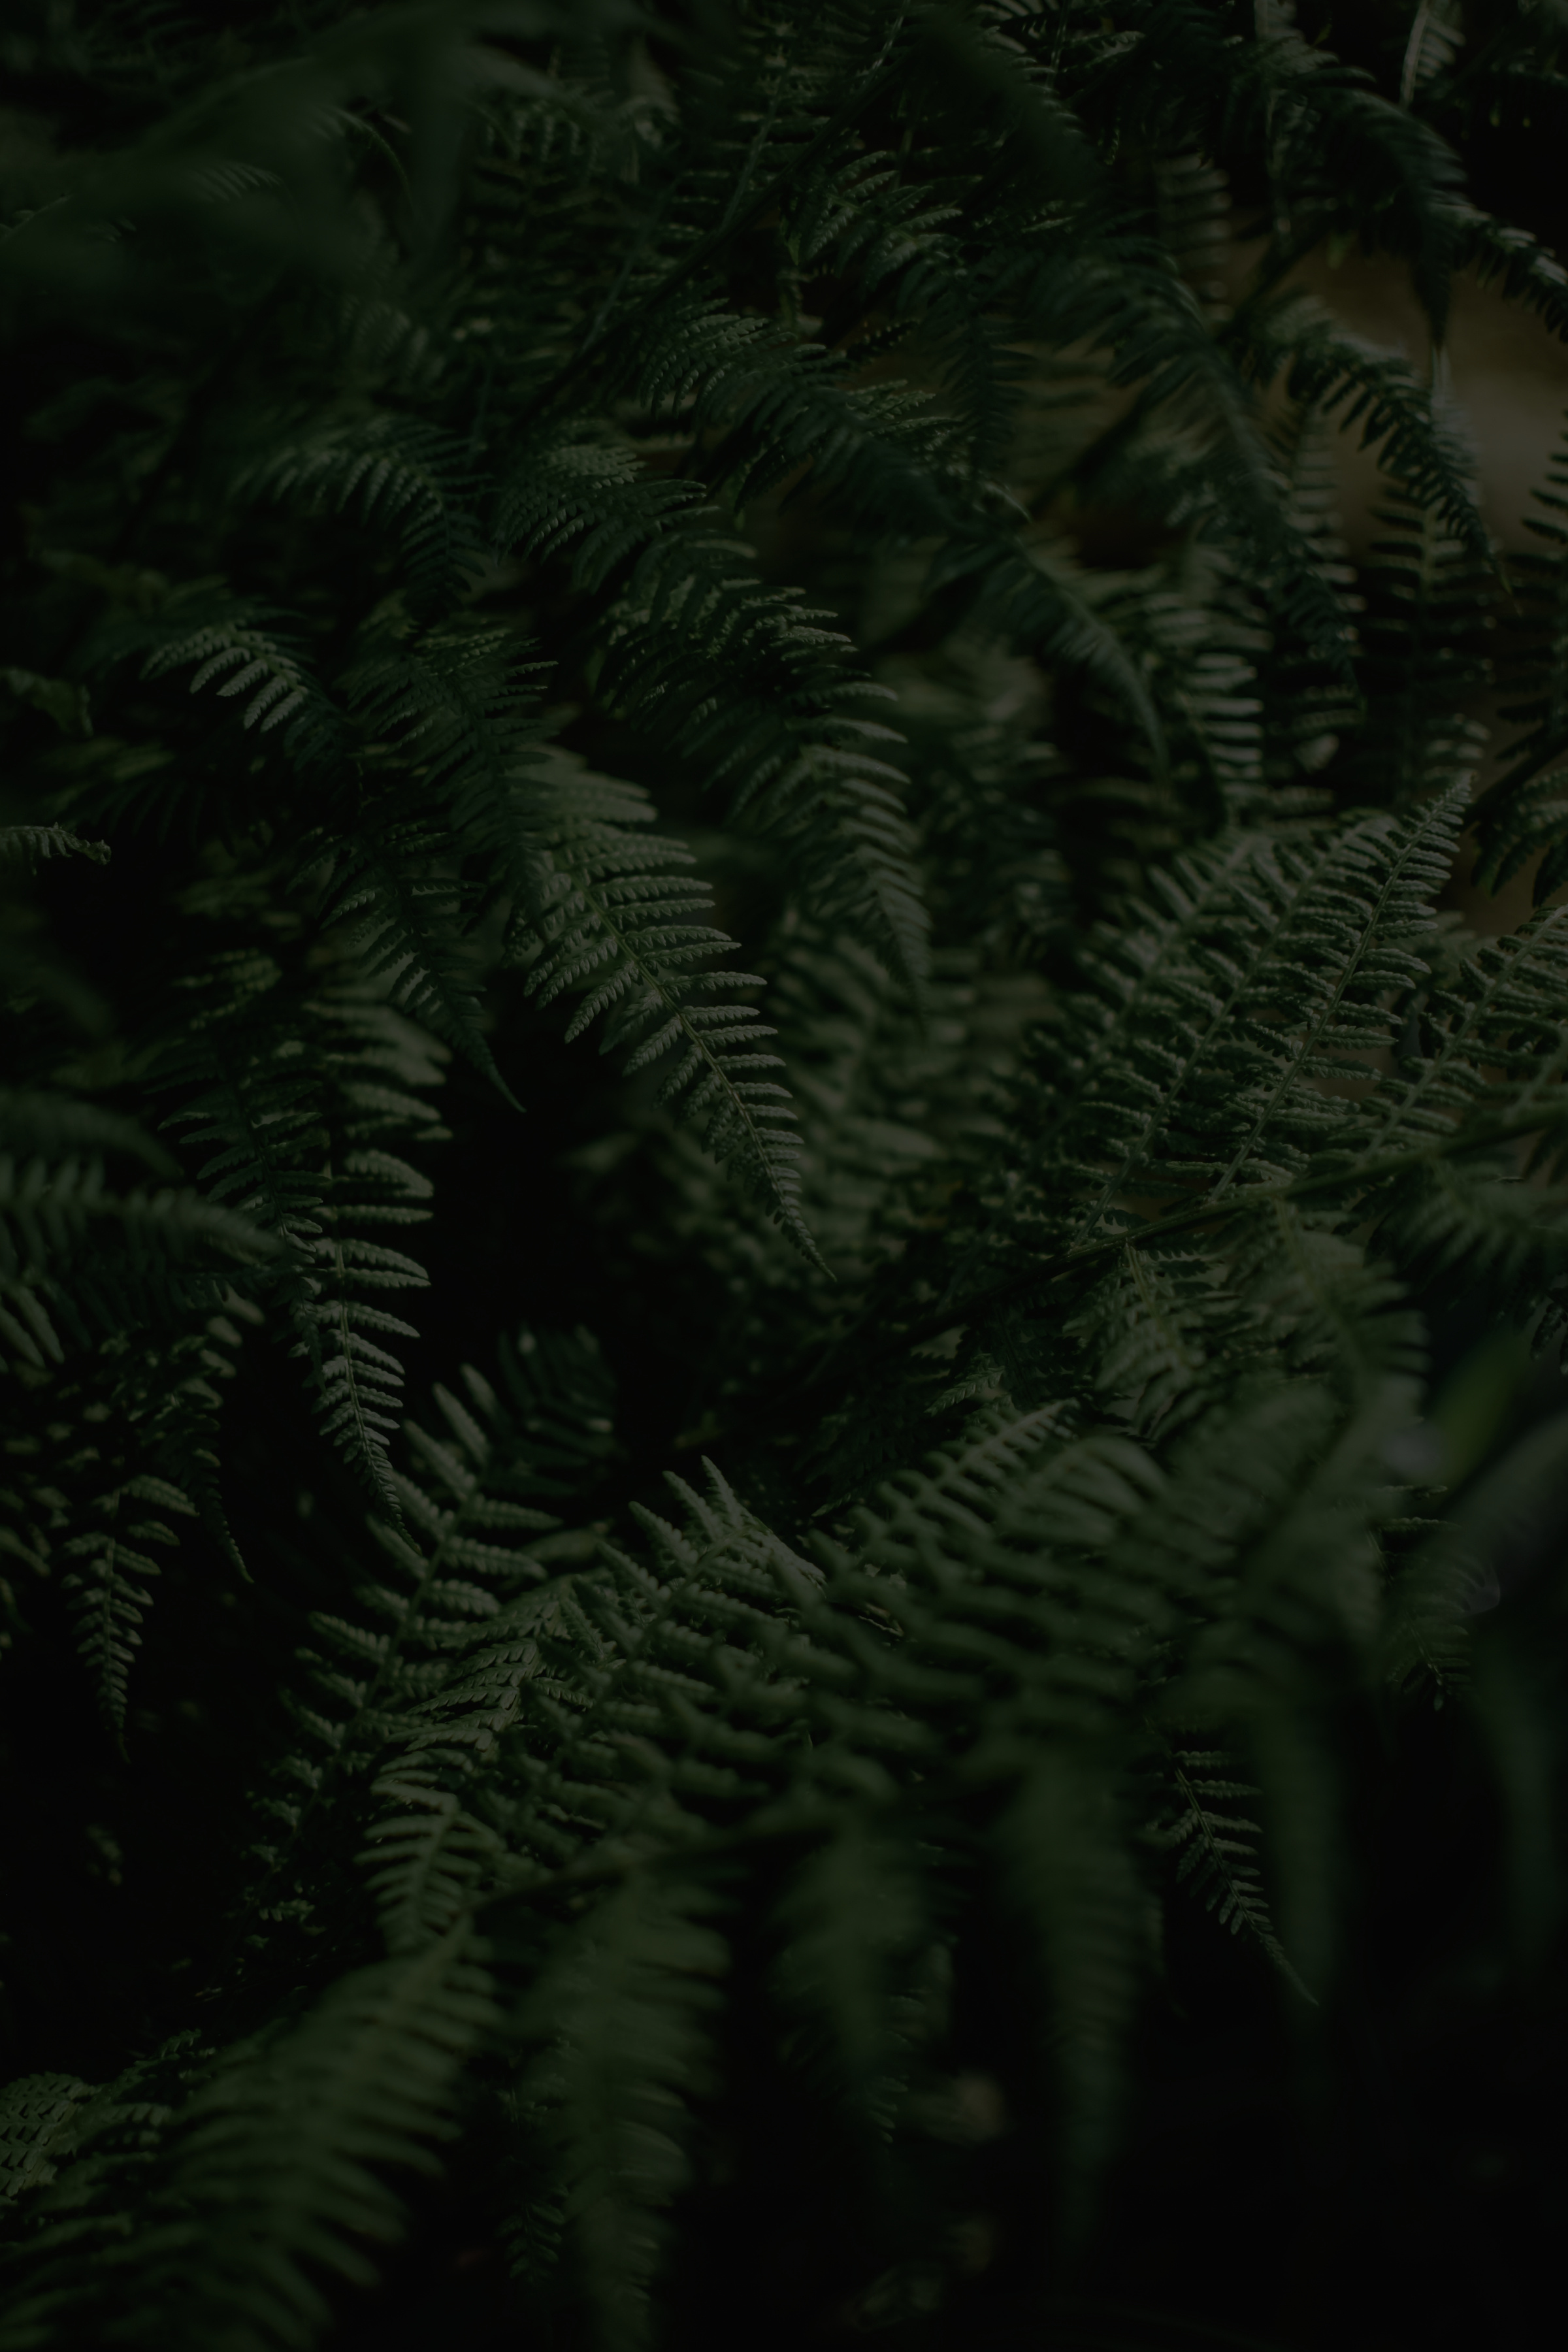
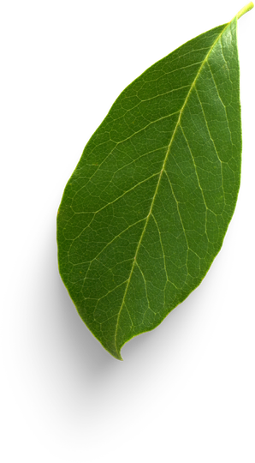
BORCELLE
THANK YOU
THANK YOU
FOR YOUR ATTENTION

