Slide 1

COURSEWORK COVERSHEET AND RECEIPT
(This form must be completed and attached to all assessed coursework)
BCUIC ID Number: | 172036
First Name: (PLEASE USE BLOCK CAPITALS) | PHUONG VI | Family Name: (PLEASE USE BLOCK CAPITALS) | NGUYEN
Choose BCUIC Course:
 | First Year Degree in Business First Year Degree in Economics and Finance First Year Degree in Accountancy and Finance First Year Degree in Marketing, Advertising and PR First Year Degree in Technology, Engineering and Built Environment
 | Pre-masters in Art & Design Pre-masters in Law Pre-master in Business Pre-master in Technology, Engineering and Built Environment
x | Foundation in Art & Design Foundation in Law Foundation in Business Foundation in Technology, Engineering and Built Environment
Module Code: ART104 | Module Name: Personal Experimental Studies in Art and Design
Lecturer/Tutor: Bhavik Sharma
Assignment Title: The root of memory – ART104
Type “YES” if you have uploaded your work on TURNITIN:
Type “YES” if you have applied for Mitigating Circumstances:
Declaration: I can confirm that the work that I have submitted is my own original work and that I have made appropriate references to any sources used. I have read and understand that BCUIC plagiarism and collusion policy in the Academic Services/Student Handbook and confirm that this work complies with those guidelines. I confirm that the printed version of the assessment and any electronic copy I am required to submit via TURNITIN are identical. I understand that failure to meet the guidelines may result in one or more of the outlines penalties being imposed.
Signed: Phuong Vi Nguyen Date: 05/08/2026

Slide 2
ASSESSMENT & EXAMINATION FEEDBACK FORM
MODULE CODE | ART104 | STUDENT ID | 172036
SEMESTER | 2602 | DATE | 05/08/2026
Additional Guidance:
Feedback provided in this form should be accompanied by corresponding annotations on the student’s script in the appropriate colour as follows:
RED = FIRST MARKER
GREEN = SECOND MARKER
The First Mark stands as the ‘Agreed Mark’ unless there is a deviation beyond 10%
Agreed Mark section is to be completed by the Second Marker with the mark entered matching the First Mark where there is a deviation of less than 10% to indicate agreement/confirmation. The additional section added for ‘Agreed Mark’ is to be completed / signed by the Second Marker where the deviation is less than 10%.
Where there is a deviation of more than 10% the First Marker and Second Marker are to consult further to reach a consensus on the Agreed Mark.
If a consensus cannot be reached between the First Marker and Second Marker a Third Marker / Moderator will be appointed by the Academic Services Team to confirm the Agreed Mark.
Where there is a deviation of more than 10% the First Marker and Second Marker are to consult further to reach a consensus on the Agreed Mark.
WordPress link | https://mango491.wordpress.com/
Section A
 | Mark Allocated | Percentage % | Signature
First Marker
Second marker
Agreed mark
Moderator (if applicable)
Signature (Moderator)
FIRST MARKER NAME (PRINT) |  | FIRST MARKER (SIGNATURE)

Slide 3
Section B (see comments below)
Overall Comments:
­­­­­­­­­Tips to improve your work (1st Marker) 1. 2. 3. The best part of the work was: ­­­­­­­­­­­­­­­
Second Markers Comments
I confirm agreement with the marking standards of this sample ☐ YES ☐ NO
___________________________________________________________________________________________________________________________________
___________________________________________________________________________________________________________________________________
___________________________________________________________________________________________________________________________________
Second Marker Signature:

Slide 4
Please delete this sentence and insert your work here:
If the formatting of your work is affected when pasted in this document, please try to copy this form at the beginning of your document. If you can’t keep the formatting of your work to the original, please do not worry as this will not affect your mark.

Slide 5
My Theme
ID:25185750
THE ROOT OF MEMORY
Phuong Vi Nguyen

Slide 6
The root of memory
  Create a place to draw people's attention to the garden and showcase Vietnamese architecture.
  Target audience: the citizens live surrounding (every age)
  Healing over Erasing: The Jardin d'Agronomie Tropicale was once forgotten, devastated by fire, and abandoned, as it held memories that were deeply painful and complex.

Slide 7
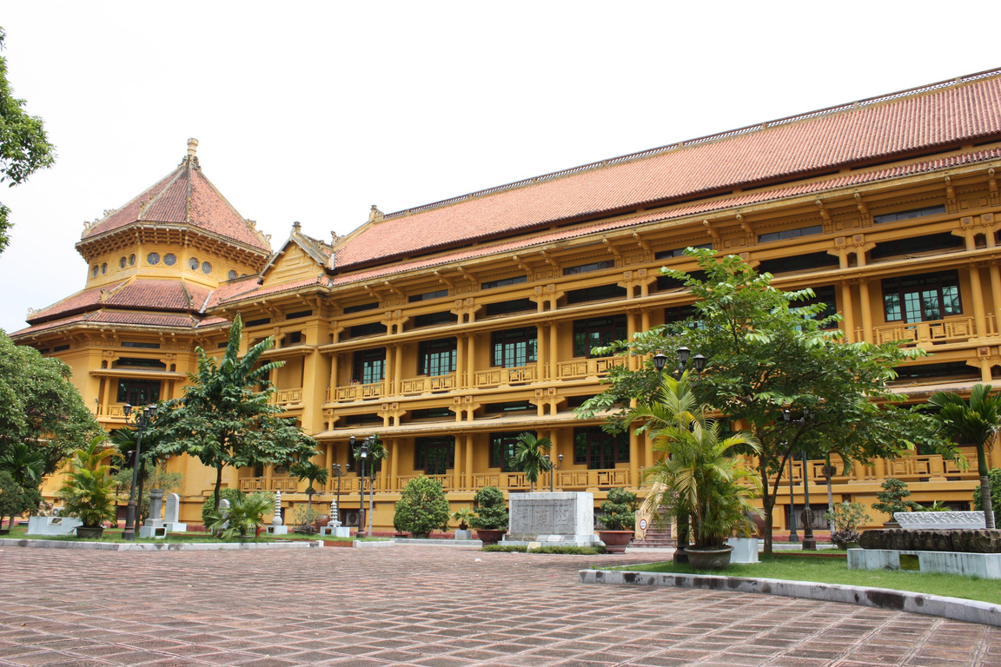
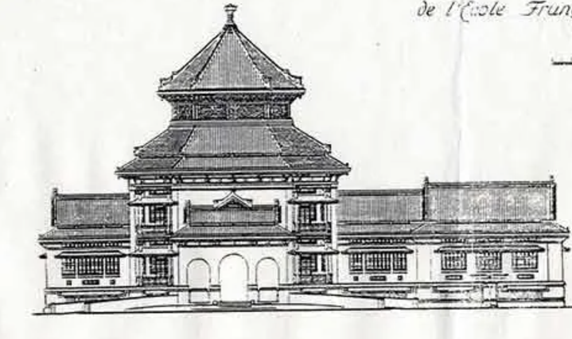
Research
Ernest Hebrard (1875-1933)
  The French influence in Vietnam in WWI
  Indochina Style
  The hybridity technique
  Vietnamese
  My culture and my country

Slide 8

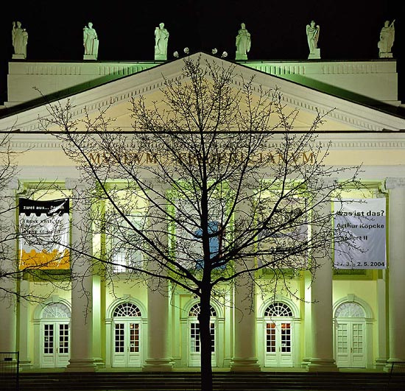
Research
Joseph Beuys
  Project : 7000 Oaks (Kassel, German, 1982)
Environmentally friendly materials
No negative impact on the landscape
Raising awareness of environmental issues

Slide 9
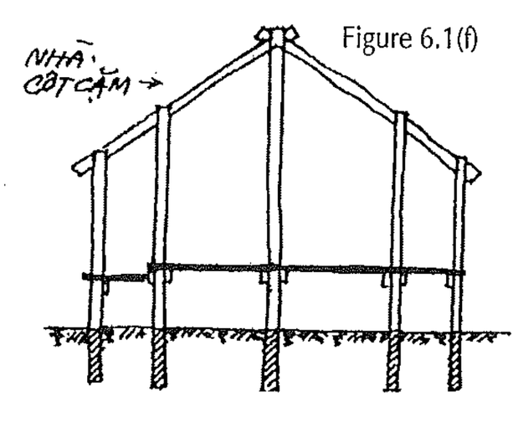
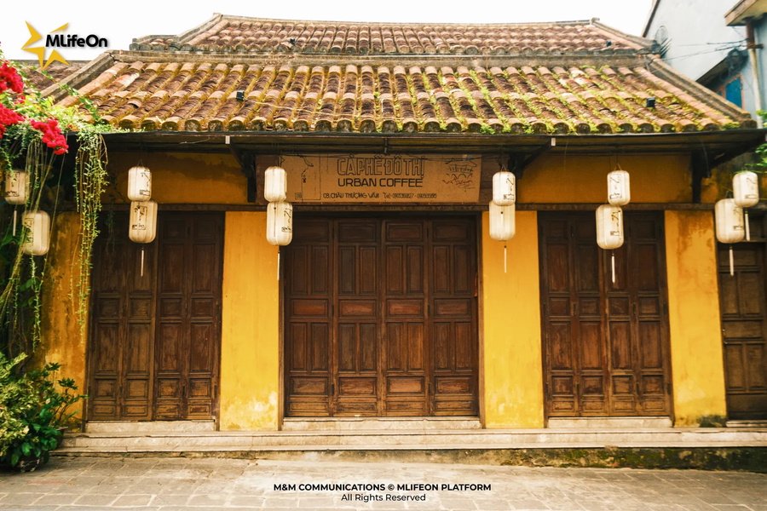
Research
Chinese influence
the Vietnamese northerners had adopted the Chinese preference
Yin-Yang roofing tiles consist of two types, facing tiles (Yang) and facing tiles (Yin) tiles, interlocked to create a distinctive undulating roof surface.

Slide 10
Art movement
ECO-ART
  The web of interdependent relationships within the environment, encompassing the physical, biological, cultural, political, and historical aspects of ecosystems.
  natural materials or engage directly with environmental
  Eco-art serves to inform the public about ecological dynamics and the environmental challenges we face.
  These practices help reimagine ecological relationships, thereby proposing new possibilities for coexistence, sustainability, and healing.

Slide 11
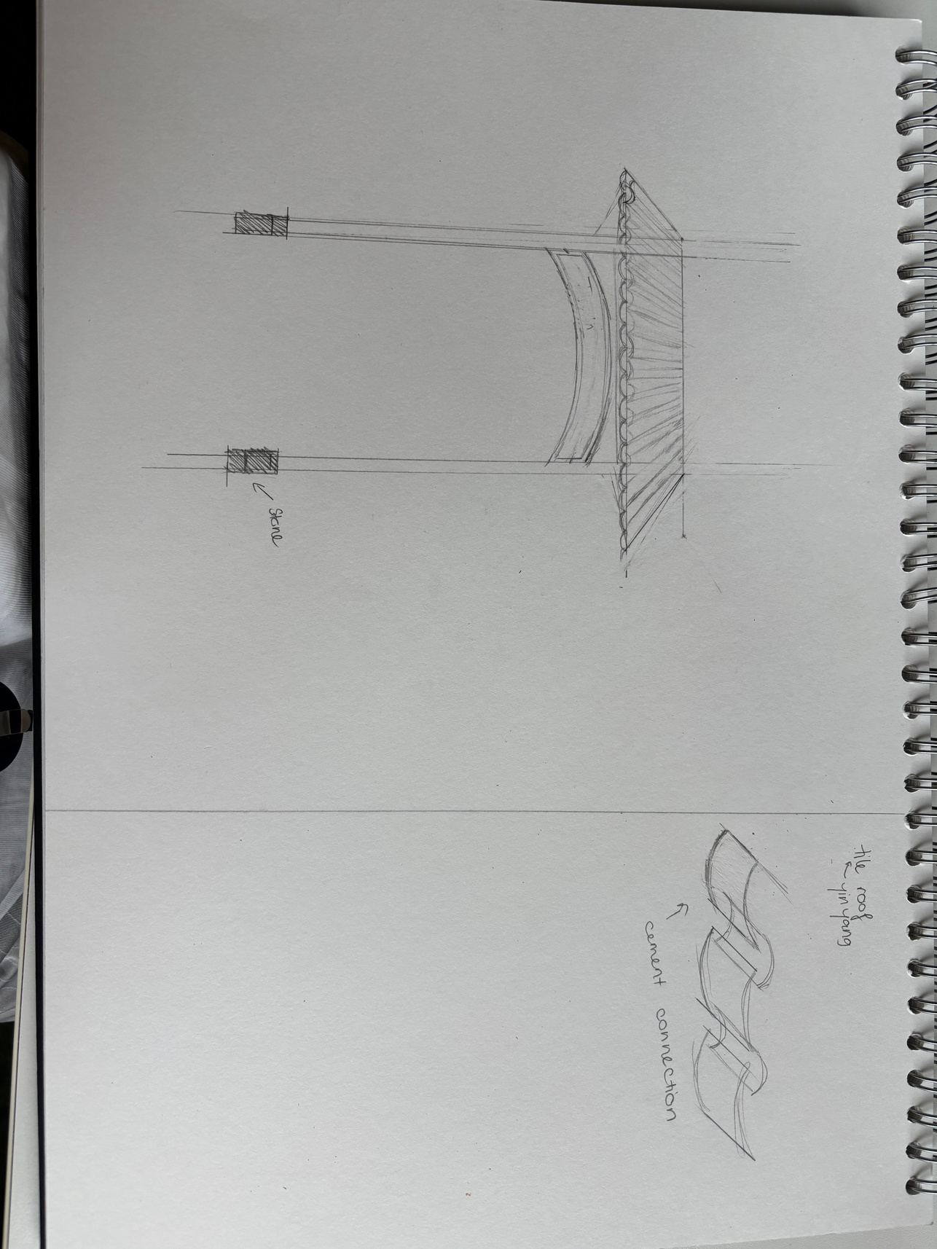
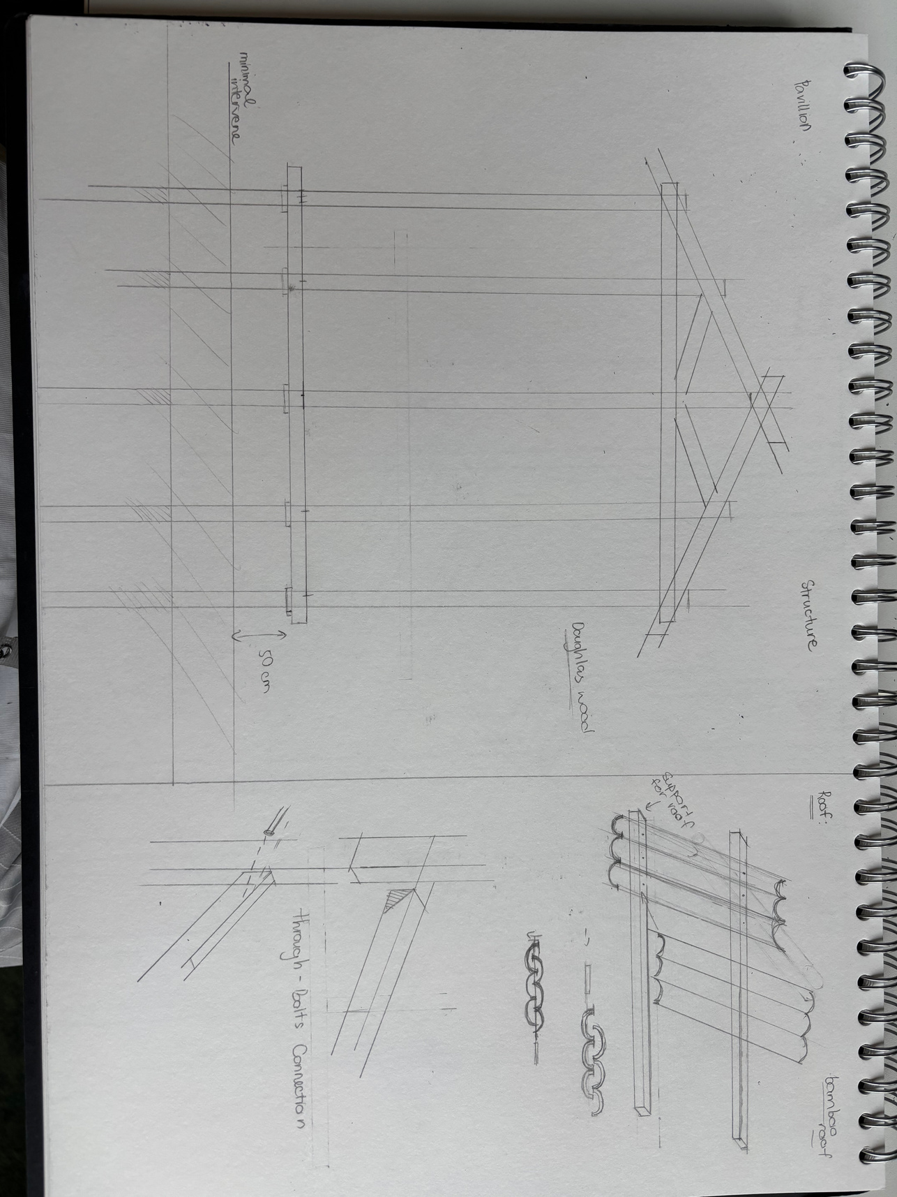
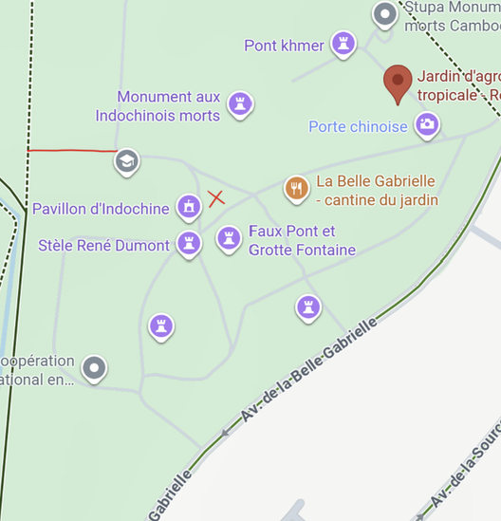
Design Idea

Slide 12
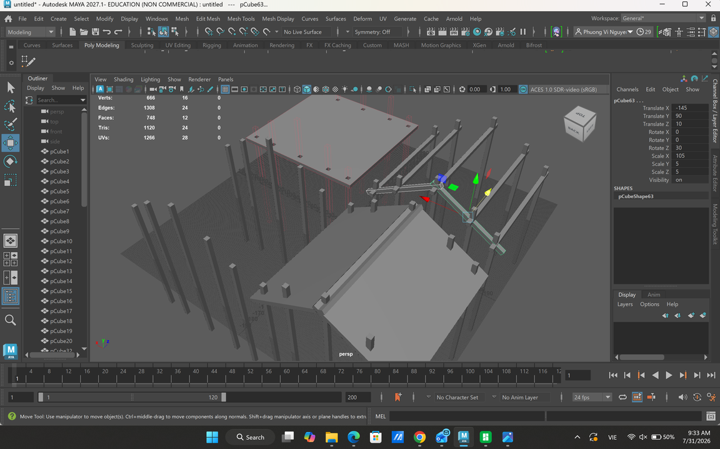
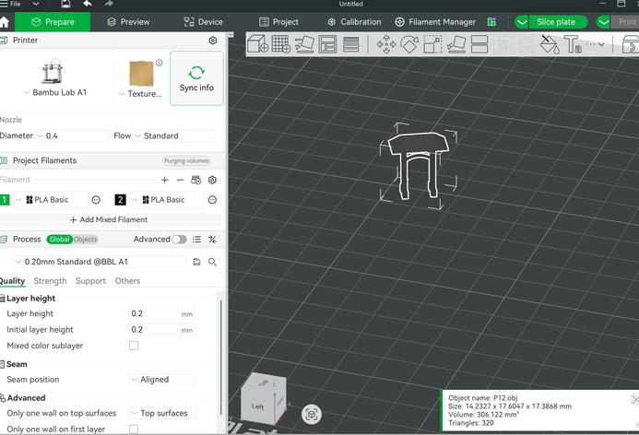
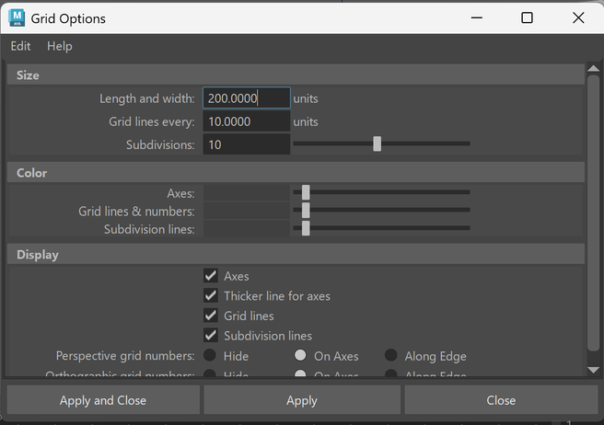
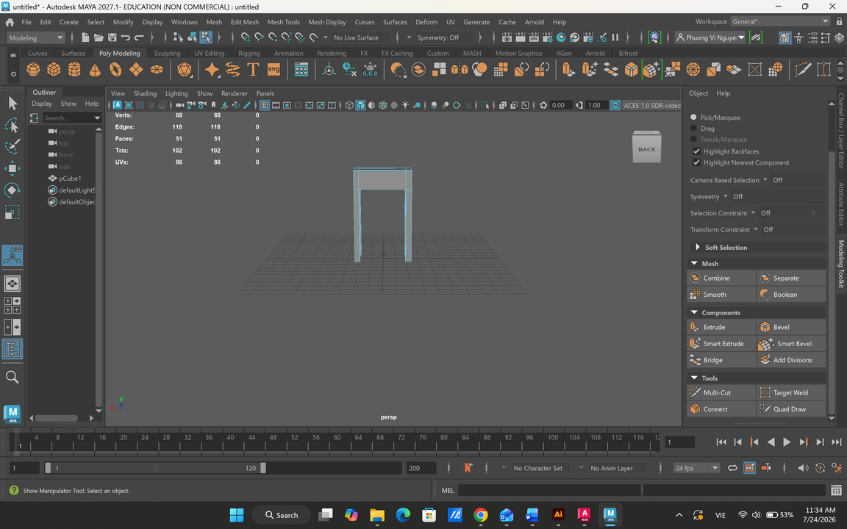
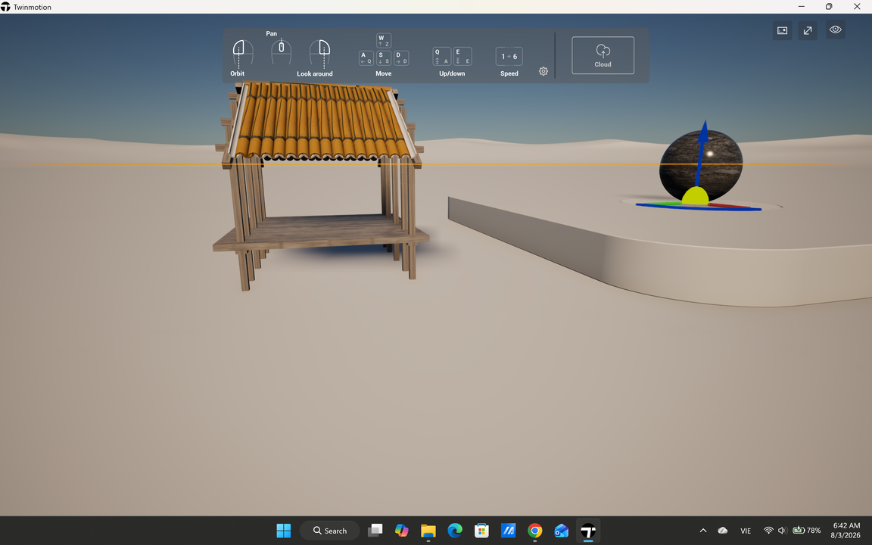
Digital skill
Maya Autodesk
Twinmotion

Slide 13
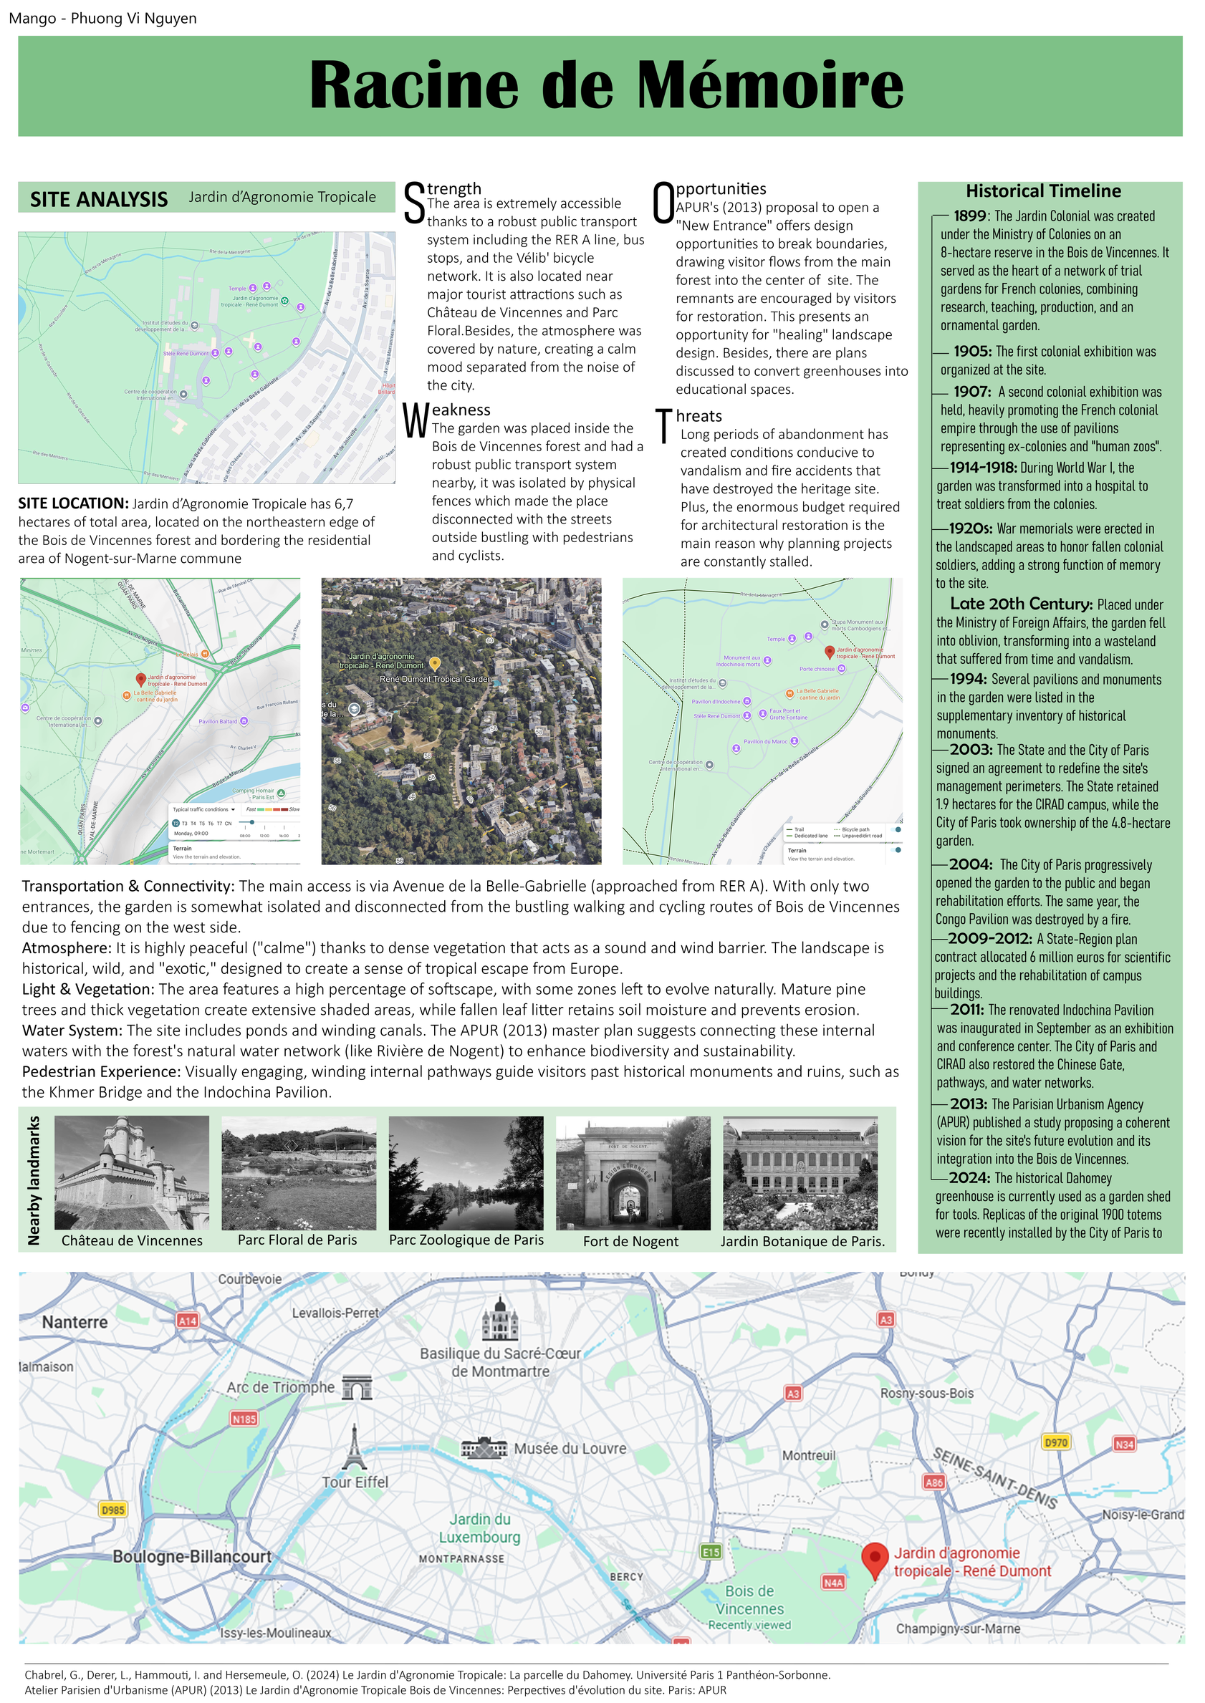
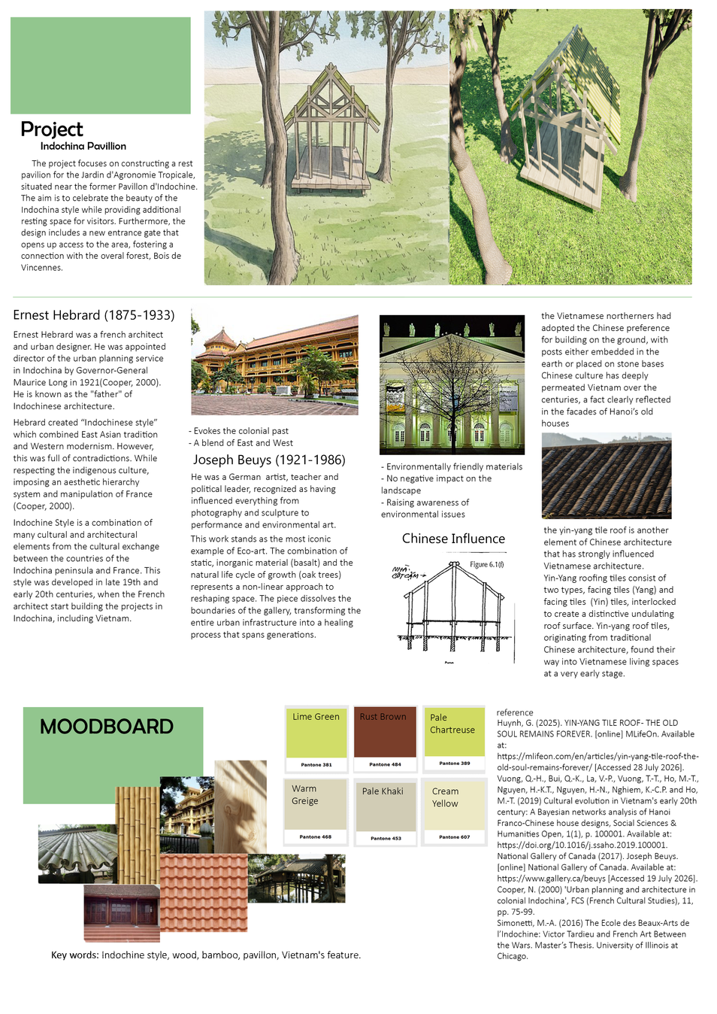
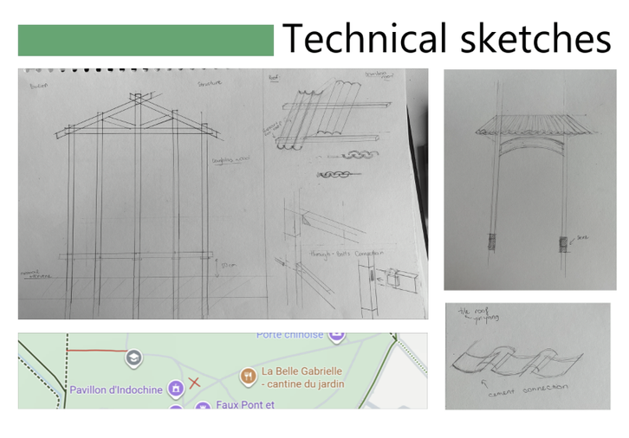

Slide 14
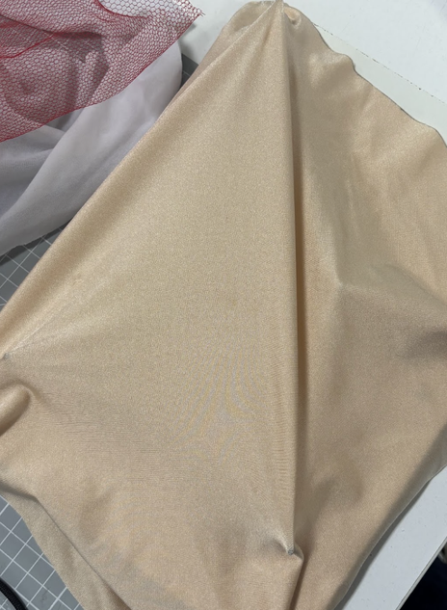
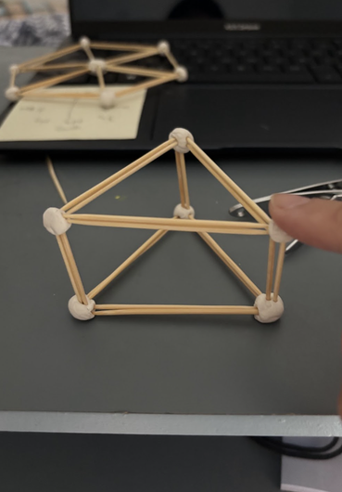
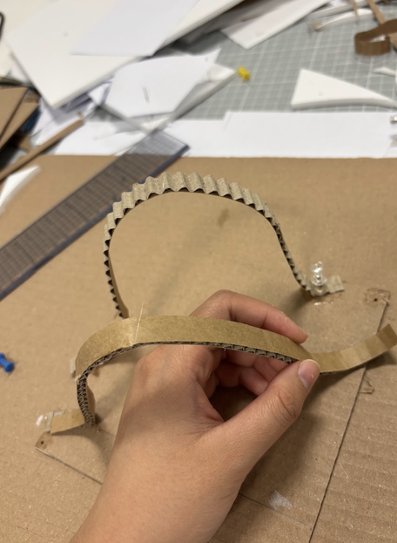
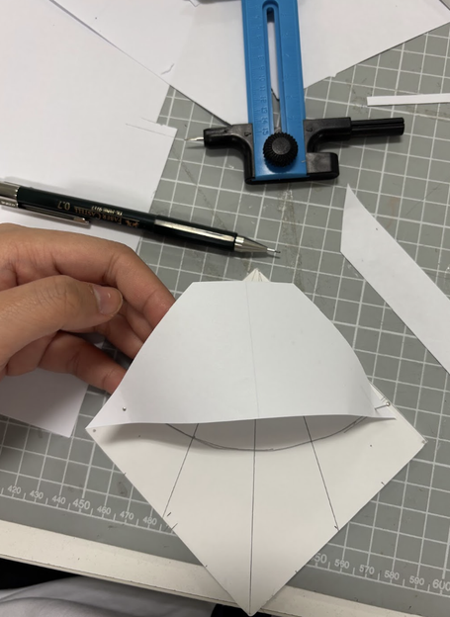
Model making
I develop more in my modeling skills
Learning new skills in modeling

Slide 15
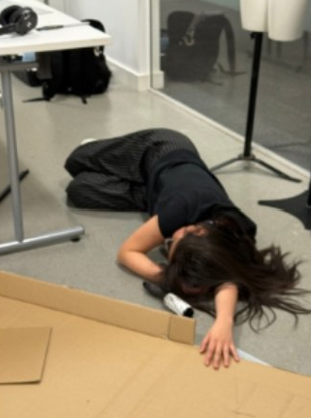
Challenge
  Balance
  Time management
  Burn out

Slide 16
Time at BCUIC
  Busy and pressure
  Overthinking and negative though
  Broaden perspective
  Not easy
  Learn many valuable lessons

Slide 17
Reference list:
Huynh, G. (2025). YIN-YANG TILE ROOF - THE OLD SOUL REMAINS FOREVER. [online] MLifeOn. Available at: https://mlifeon.com/en/articles/yin-yang-tile-roof-the-old-soul-remains-forever/ [Accessed 28 July 2026].
Vuong, Q.-H., Bui, Q.-K., La, V.-P., Vuong, T.-T., Ho, M.-T., Nguyen, H.-K.T., Nguyen, H.-N., Nghiem, K.-C.P. and Ho, M.-T. (2019) Cultural evolution in Vietnam's early 20th century: A Bayesian networks analysis of Hanoi Franco-Chinese house designs, Social Sciences & Humanities Open, 1(1), p. 100001. Available at: https://doi.org/10.1016/j.ssaho.2019.100001.
National Gallery of Canada (2017). Joseph Beuys. [online] National Gallery of Canada. Available at: https://www.gallery.ca/beuys [Accessed 19 July 2026].
Cooper, N. (2000) 'Urban planning and architecture in colonial Indochina', FCS (French Cultural Studies), 11, pp. 75-99.
Simonetti, M.-A. (2016) The Ecole des Beaux-Arts de l’Indochine: Victor Tardieu and French Art Between the Wars. Master’s Thesis. University of Illinois at Chicago.
Chabrel, G., Derer, L., Hammouti, I. and Hersemeule, O. (2024) Le Jardin d'Agronomie Tropicale: La parcelle du Dahomey. Université Paris 1 Panthéon-Sorbonne.
Atelier Parisien d'Urbanisme (APUR) (2013) Le Jardin d'Agronomie Tropicale Bois de Vincennes: Perpectives d'évolution du site. Paris: APUR
Kagan, S. (2014). The practice of ecological art.
Golosova, E.V. and Chu, H.M. (2019). The gardens and architecture of the imperial burial complexes of Vietnam as a result of the influence of Chinese culture on the countries of Woutheast Asia. [online] Amazonia Investiga, 8(21), pp. 491–499. Available at: http://www.udla.edu.co/revistas/index.php/amazonia-investiga.[Accessed 28 July 2026]

Slide 18
THANK YOU

Slide 19
QUESTIONS??

